Slide 1
Stages of Endometriosis

Slide 2
Stages
The staging of endometriosis is typically based on visual inspection during laparoscopy. Laparoscopy is the operation used for diagnosis.
There are 4 stages; I to IV or minimal to severe.
​Staging does not affect your treatment. Treatment is based on your symptoms. ​
(1)

Slide 3
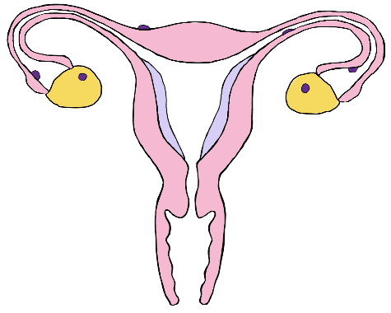
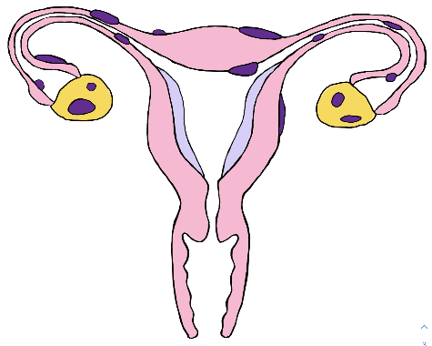
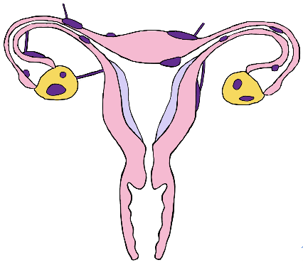
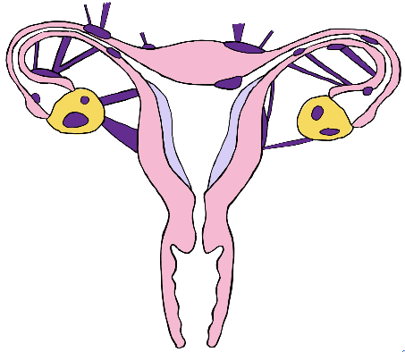
I | Minimal | Small, superficial lesions
II | Mild | Larger lesions, some of which are imbedded deeply
III | Moderate | Larger lesions which are imbedded more deeply and have adhesions.
IV | Severe | Large, deep lesions with dense adhesions
(1)

