Slide 1
Symptoms in endometriosis and what causes them?

Slide 2
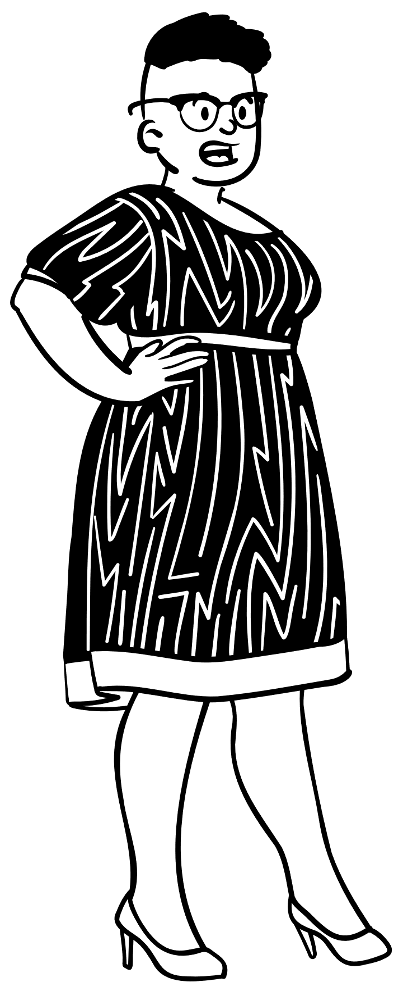
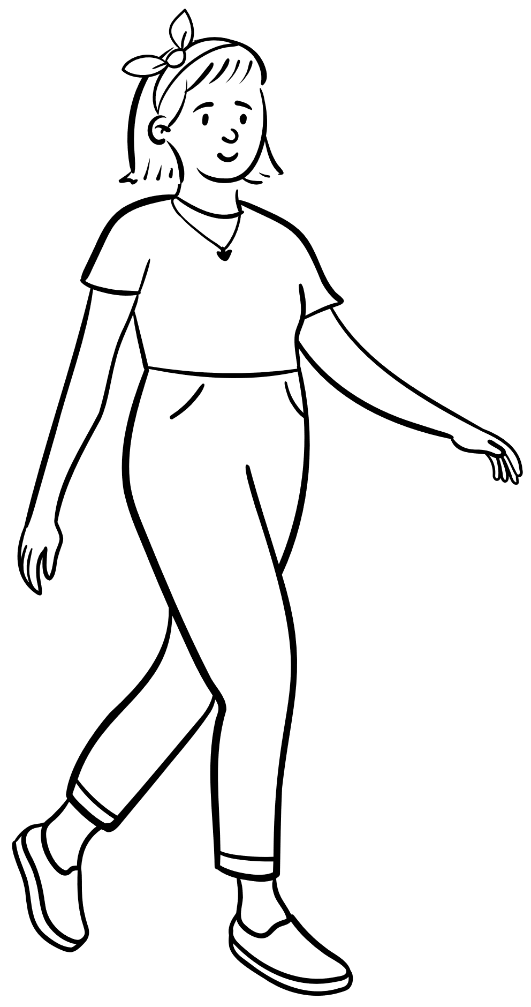
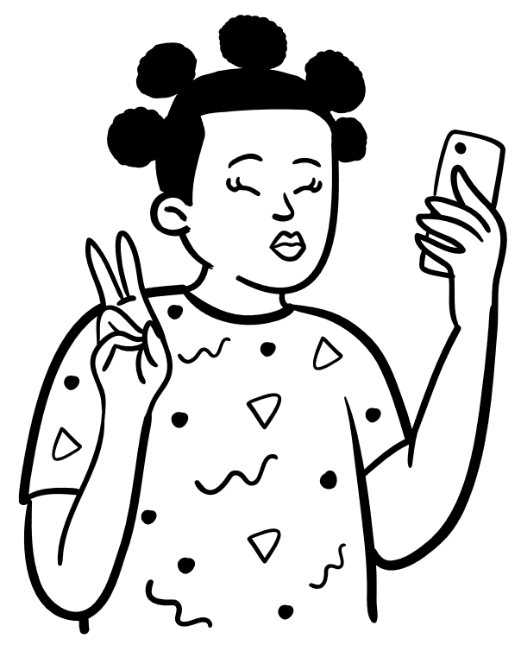
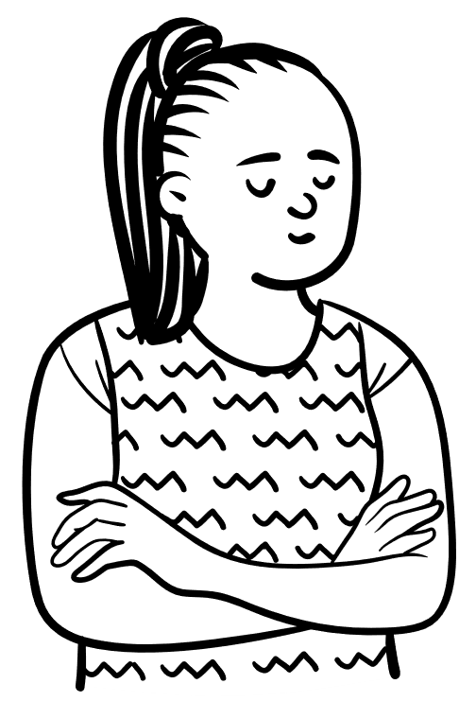
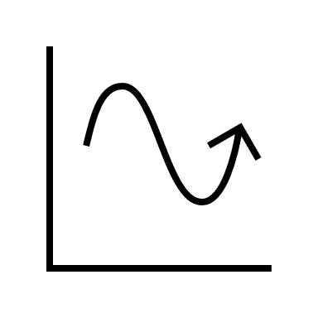
Endometriosis can cause many different symptoms that are often vague
Each person’s symptoms are different and the list of symptoms is non-exhaustive
Patients often have pain that coincides with their
menstrual cycle
(1)

Slide 3
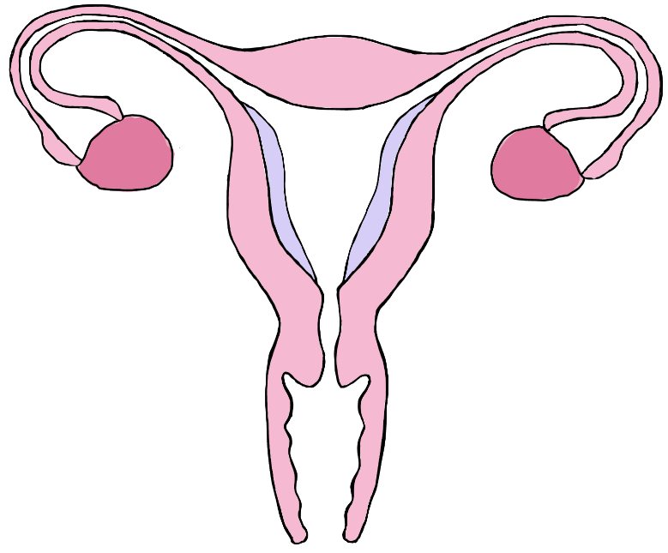
Period changes
Pain
Heavy, irregular or painful periods
Pelvic pain
Cramping period pain
Pain after sex
Painful bowel movements
Pain during urinating
Subfertility
Stomach problems
Diarrhoea
Constipation
Nausea
Bloating
Difficulty getting pregnant- this does not happen to everyone with endometriosis but some patients do struggle becoming pregnant
(1)

Slide 4
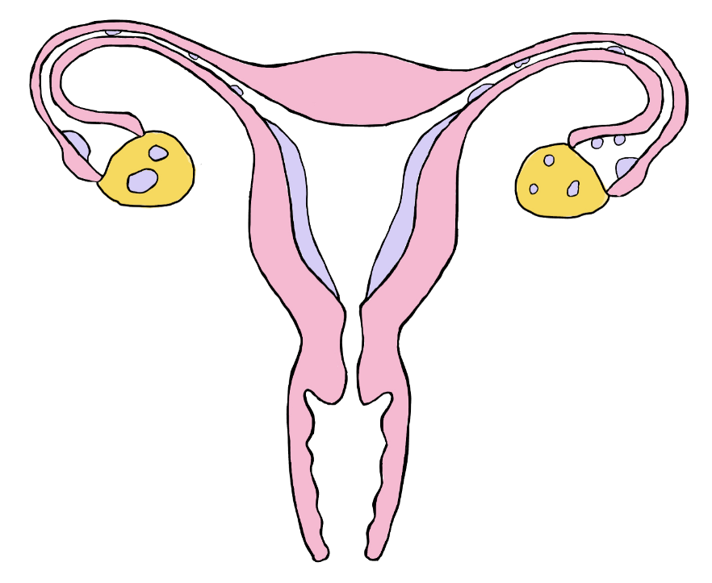
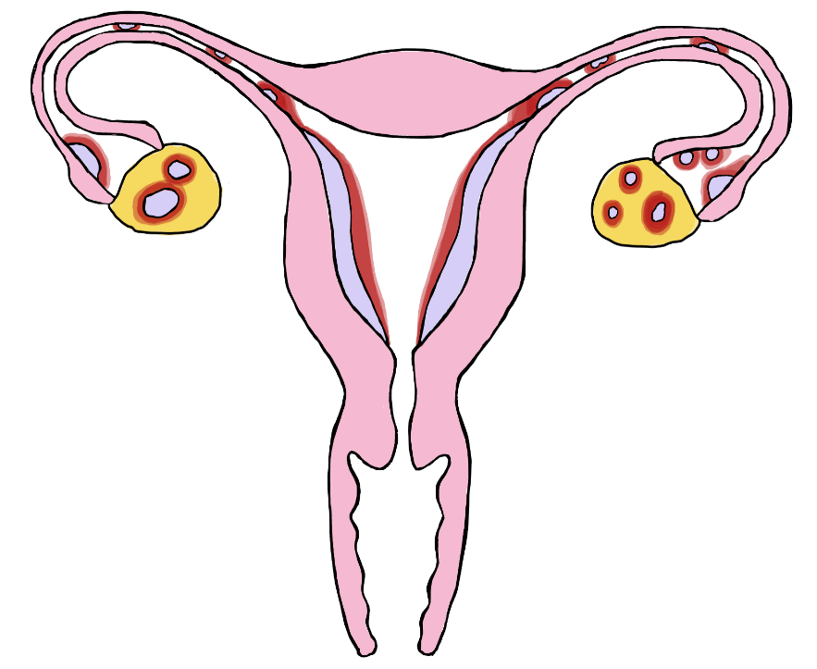
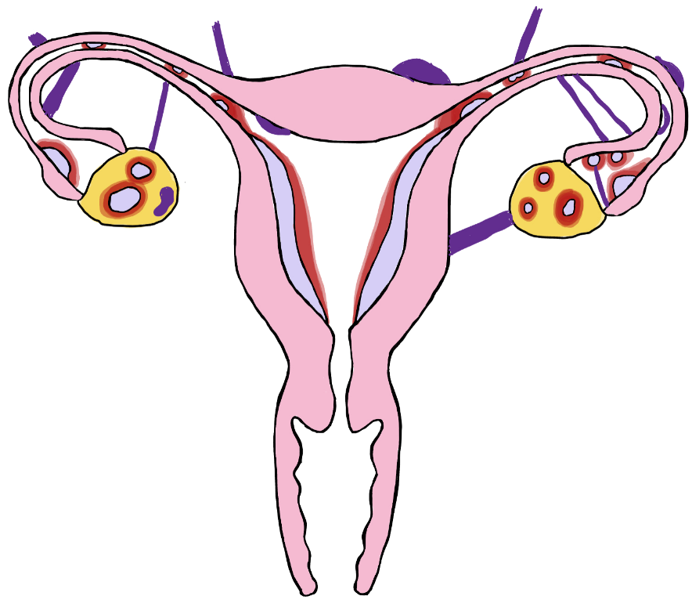
The endometrial tissue grows and bleeds in response to the hormones that your body releases to control your menstrual cycle
As your hormone levels change throughout the month, the endometrial tissue responds by swelling and bleeding
This can cause pain and changes to your periods
This process of swelling and bleeding can cause the development of scar tissue and adhesions between your organs
This can lead to pain and difficulty getting pregnant
(2)

Slide 5
What causes endometriosis?
The exact cause of endometriosis is unknown
Several theories have tried to explain the cause of endometriosis, but none of these fully explain what causes endometriosis
(2)

Slide 6
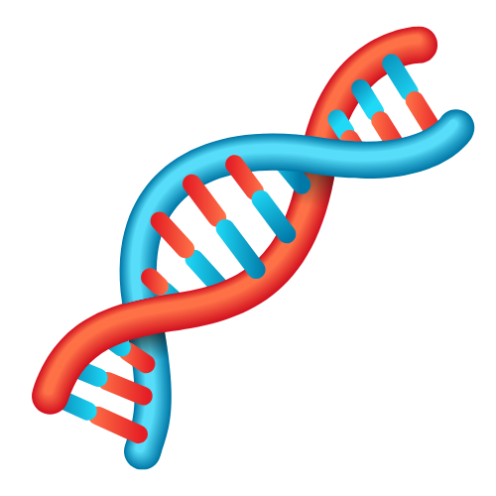
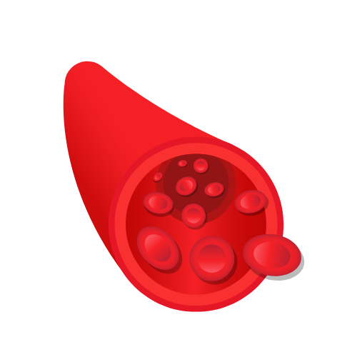
What causes endometriosis?
Genetics
A problem with the body's immune system
BUT...
None of these theories fully explain the cause of endometriosis.
The spread of endometrial cells through the bloodstream and lymphatic syndrome
(2)

