Slide 1

Northern Lincolnshire and Goole NHS Foundation Trust
Annual Members’ Meeting
Thursday 12 September 2024

Slide 2
Introduction and welcome
Sean Lyons
Chair

Slide 3
Agenda
Overview of 2023/24 and plans for 2024/25 2.05pm
Jonathan Lofthouse, Group Chief Executive
Financial performance review 2023/24 2.20pm
Philippa Russell, Deputy Group Chief Financial Officer
Annual Audit Report for 2023/24 2.35pm
Brian Clerkin, Sumer Auditco NI Limited, the trust’s external auditors
Public health in Northern Lincolnshire 2.50pm
Diane Lee, Director of Public Health for Northern Lincolnshire
Governor elections 3.20pm
Alison Hurley, Deputy Director of Assurance

Slide 4
Overview of 2023/24 and plans for 2024/25
Jonathan Lofthouse
Group Chief Executive

Slide 5
Group milestones
Chief Executive
  Dr Peter Reading left in May 2023
  Group Chief Executive started in August 2023
Trust Boards and Committees in Common
Executive team
New operational structure – 14 Care Groups
Name for our group - NHS Humber Health Partnership

Slide 6
Group milestones
Significant staff and stakeholder engagement – thank you as Governors for your time, energy and input into:
New vision statement:
United by Compassion, Driving for Excellence
New set of values:
Compassion, Honesty, Respect and Teamwork
Ambitious Strategic Framework, based on reducing health inequalities and improving outcomes

Slide 7
Strategic framework
United by Compassion – Driving for Excellence
Excellent care
Led by our values
Focused on four pillars
Delivered through
Underpinned by
Delivering excellence
Our Ambition is
Compassion
People
Digital innovation and digital inclusion
Our people feel proud to work here
Excellent care
To provide excellent care that meets our population’s diverse needs.
Equity
Performance
Patients get the best care
Honesty
Partnerships
Healthier communities
Leadership capacity and capability
Quality and Safety
Local people live more years in good health
Innovation
Healthier communities
Respect
To support and enable our population to live more years in good health.
Research and Innovation
We are recognised as leaders in our field
Culture for success
Care
Teamwork
Partnerships
Our communities feel proud of what we offer
Working together with our population, our partners, and our people.

Slide 8

Staff charter
COMPASSION | HONESTY | RESPECT | TEAMWORK
Put the safety and care of patients and colleagues at the heart of everything you do | Take responsibility for your actions, decisions and behaviours | Trust and appreciate your colleagues - say thank you and well done | Meet regularly as a whole team, discuss goals, actions and ideas for improvement. Commit to being good team members
Listen to your colleagues and patients, understand, empathise and take action to help | Report concerns about safety, quality and negative behaviours as quickly as possible | Talk to everyone in a respectful and polite manner and listen when others want to speak | Include all colleagues in key discussions about the team or service
Treat everyone with kindness and support those who need assistance or guidance | Communicate constantly and clearly at all times; create and respond to a constant loop of honest feedback | Understand and appreciate the perspectives, choices and beliefs of others and never discriminate against anyone | Tackle poor behaviours as they arise
Do the right thing, even if this is more difficult to do | Be open about mistakes, apologise, learn and improve | Respect and use each others’ strengths; act respectfully by giving, receiving and acting on constructive feedback | Agree high professional standards as a team; give yourselves time to reflect on how to constantly improve

Slide 9
Activity levels
 | 2021/22 | 2022/23 | 2023/24
ED attendances at Grimsby and Scunthorpe | 147,849 | 152,856 | 174,008
Admissions into hospital | 111,675 | 122,990 | 118,523
Number of discharges (patients leaving hospital) | 111,613 | 122,951 | 118,174
Outpatient appointments (Attendances) | 398,317 | 417,903 | 339,021
Births | 3,802 | 3,719 | 3,703
Patients who were admitted as an emergency | 33,172 | 24,911 | 26,288
Total number of operations in theatre | 16,171 | 17,544 | 19,743
Total number of elective operations in theatre | 11,677 | 12,911 | 14,965

Slide 10
Trust performance in 2023/24
Patients seen within four hours in the Emergency Department – 63.2%
Provided mutual aid for elective recovery to other hospitals
Delivered our financial plan
Reduced the number of patients waiting longer than 65 weeks for elective care
However, we remain an outlier on four-hour performance, ambulance handover times and cancer treatment times

Slide 11
Significant milestones
Opened new Same Day Emergency Care and Integrated Acute Assessment Units at both Grimsby and Scunthorpe
Started work on Community Diagnostic Centres in Grimsby and Scunthorpe
Introduced a new Patient Administration System
Completed Humber Acute Services consultation, now planning for implementation (ICB-led process)

Slide 12
Priorities for 2024/25
Patient flow - emergency care performance and ambulance handovers
Cancer and elective waiting lists reduction
Start process to procure a new group-wide Electronic Patient Record system – key enabler in transforming clinical pathways and improving efficient care delivery
Staff – recruitment and retention, leadership development and health and wellbeing
Financial plan

Slide 13
Questions

Slide 14
Financial performance review 2023/24
Philippa Russell
Deputy Group Chief Financial Officer

Slide 15
Independent Auditor's report to the Council of Governors of Northern Lincolnshire and Goole NHS Foundation Trust
“In our opinion the financial statements:
…give a true and fair view of the financial position of Northern Lincolnshire and Goole NHS Foundation Trust as at 31 March 2024 and of its expenditure and income for the year then ended;
…have been properly prepared in accordance with the Department of Health and Social Care Group Accounting Manual 2023-24; and
…have been prepared in accordance with the National Health Service Act 2006.”

Slide 16
Basis for Opinion
“…..We believe that the audit evidence we have obtained is sufficient and appropriate to provide a basis for our opinion.”
Going Concern
“….. We have not identified any material uncertainties relating to events or conditions that, individually or collectively, may cast significant doubt on the Trust’s ability to continue as a going concern for a period of at least twelve months from when the financial statements are authorised for issue.”

Slide 17
£’000s
Deficit as per accounts (18,625)
Remove impairments 17,632
Remove grants and donation impact 953
Remove impact of DHSC procured inventories 165
Adjusted Financial Position 125
Control Total 0
Improvement on control total 125
The Trust achieved its control total in 2023/24:

Slide 18
Financial regime 2023/24
Block funding continued for non-elective and emergency care – with inflationary uplifts. Planned care moved to a variable contract
The Elective Recovery Fund (ERF) continued to incentivise the delivery of elective activity to reduce waiting times using 2019/20 activity levels as the baseline
A fixed envelope for COVID-19 costs remained within the block payment but significantly lower than previous years
Pass through funding system in place for NHSE high-cost drugs and devices

Slide 19
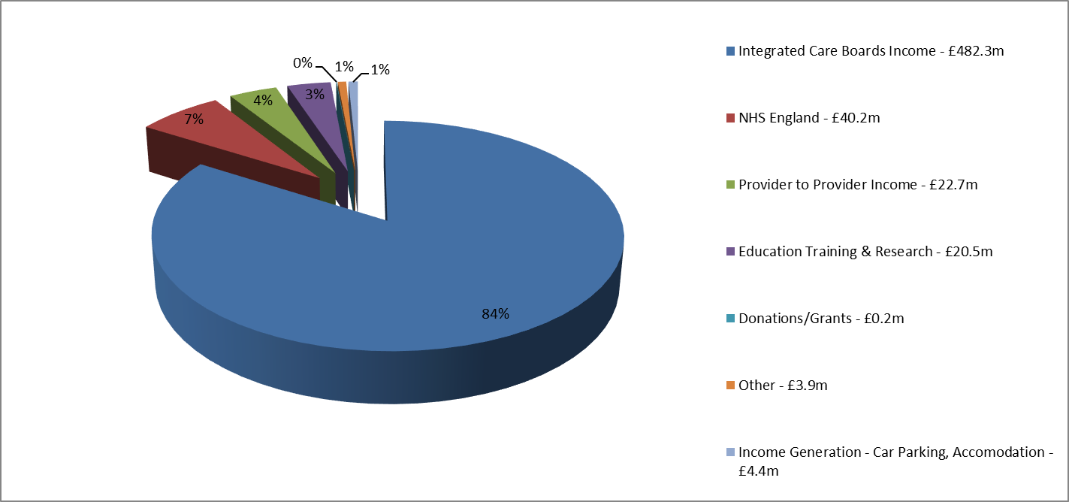
Where our money came from
Our operating income in 2023/24 was £574m, as shown below:

Slide 20
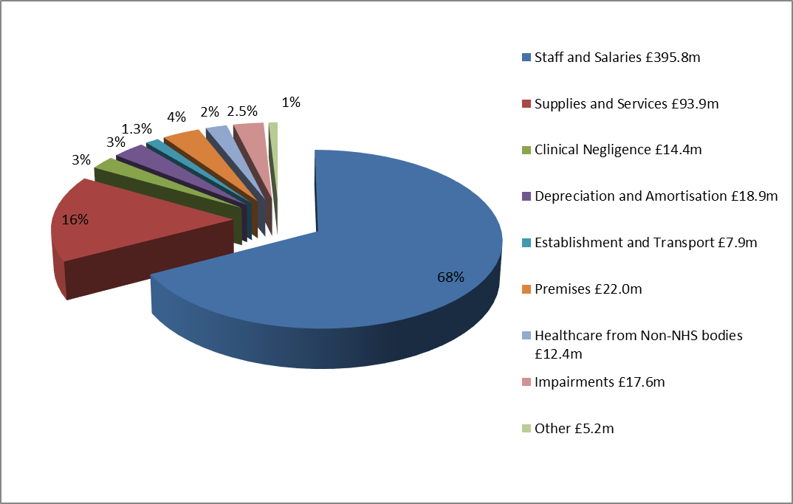
How we spent our money
Our operating expenditure in 2023/24 was £588.2m, as shown below:

Slide 21
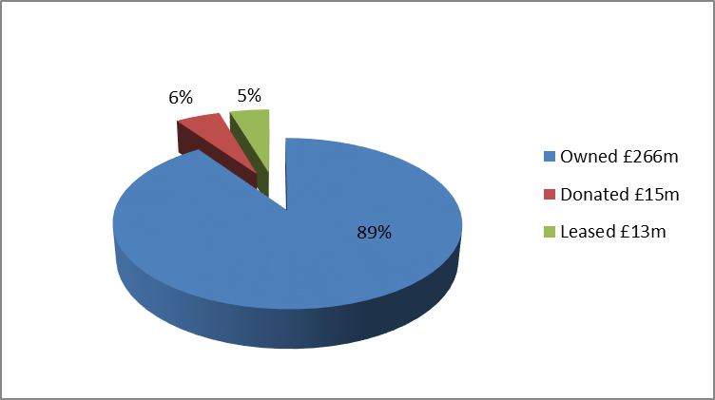
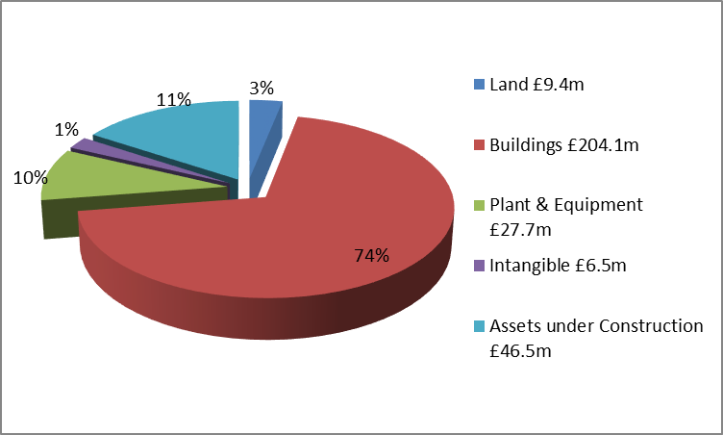
Trust asset base
The value of the Trust’s fixed assets at 31 March 2024 was £294m, as shown below.
The buildings valuation is based on a desktop revaluation from a 3rd party independent valuer.

Slide 22
Investment in infrastructure

Slide 23
Trust borrowing
Capital loans outstanding at March 24 were £6.9m.
The details are below:

Slide 24
Balance sheet strength
In overall terms the strength of the Trust’s Balance Sheet has improved this year:
  Non-Current Assets increased by £15.3m – as a result of the capital spend in year, less depreciation was incurred
  Cash and cash equivalents balance at the year-end remained stable at £41.2m, mainly due to the delay in capital spend, capital invoices due for payment in 2024/25
  Borrowings – loans have reduced from £8.2m to £6.9m, which reflects the in year payments on capital loans
  Borrowings – lease liabilities have reduced to £13m as a result of payments in year
  Performance against the Public Sector Payment Policy remained high during the year, the value of invoices paid for our Non-NHS Suppliers was 96% and 95.3% for NHS Suppliers

Slide 25
Looking ahead: underlying financial position
The Trust exited 2023/24 with an underlying recurrent deficit assessed at circa £49.7m
As at August 2024 this position has improved marginally to £46.4m. Bridging from its 2024/25 opening planned deficit of £14.9m, the main drivers of the underlying deterioration are:
  Non-recurrent savings delivery
  Reliance on non-recurrent technical savings
  Non-recurrent funding – Depreciation funding and other non-recurrent support
  Recurrent investments made without equivalent recurrent funding

Slide 26
2024/25…
The Trust agreed a deficit plan of £14.9m at the start of the year. This was part of an overall deficit across the Humber Health Partnership of £28m and £50m across the Humber and North Yorkshire ICB
In order to deliver the planned £50m deficit, the system needs to deliver £234.7m in Cost Improvements. The Trust’s contribution to this is a requirement to deliver £37.5m Cost Improvement Plans (CIP) to achieve its planned deficit of £14.9m
The Trust has a capital allocation of £39.3m, dominated largely by Community Diagnostic Centres and IM&T projects including Electronic Patient Record & Pathology LIMS (Laboratory Information Management System) programmes
Significant risks exist elsewhere within the ICB, which threaten the achievement of the overall ICB deficit total. It is not yet clear what failure to meet the ICB total would mean for individual organisations

Slide 27
Key financial risks
Delivery of the Trust’s financial plan is considered extremely high risk.
The magnitude of the efficiency plan is clearly the most challenging aspect within this. Development of the efficiency programmes is being managed through a newly formed Financial Planning Improvement Board, chaired by the Group Chief Executive. Within the evolving efficiency programme, the largest risks are:
  Delivery of additional elective activity thorough productivity gains, including the conversion of follow-up out-patient activity to new first appointments
  Delivery of length of stay reductions of our acute patients, particularly improvements to reduce the length of stay for those patients with no criteria to reside
  Finally, we need to match our long-term health needs of the population to the services we deliver as a system. The HASR process is now coming into its final phases and that needs to be concluded
Perhaps the largest risk however is not necessarily a financial one. Delivery of such a sizeable efficiency programme requires a complete change in mindset from all of our teams as well as from our system partners. This approach to change must be achieved if we are to successfully deliver our financial plans

Slide 28
Questions

Slide 29
Annual Audit Report for 2023/24
Brian Clerkin
Sumer Auditco NI Limited
External Auditors

Slide 30
Outcome of the 2023/24 Annual Audit
Audit opinion issued on 9 August 2024, in line with agreed timelines
Audit process went well
Unqualified audit opinion on the financial statements
VFM report did not identify any significant weaknesses
No other matters arising which would require us to report to the Board, AGM, Funders or Stakeholders

Slide 31
Questions

Slide 32
Public Health in Northern Lincolnshire
Diane Lee
Director of Public Health
North Lincolnshire Council
North East Lincolnshire Council

Slide 33
What is public health?
“The science and art of preventing disease, prolonging life, and promoting health through the organised efforts of society.”
Works to protect the health of communities and populations at local, regional, national, international, and global level
Shared responsibility that needs collective action
Recognition that our choices are constrained by where we live, the resources we have access to (money, transport, etc), the education we receive, the skills we learn, our friends, family, community, and more
We all have free choice, but some people’s choices are more limited than others
These are our health inequalities

Slide 34

What is public health? The Marmot Principles
Give every child the best start in life
1
Enable all children, young people, and adults to maximise their capabilities and have control over their lives
2
Create fair employment and good work for all
3
Ensure a healthy standard of living for all
4
Create and develop healthy and sustainable places and communities
5
Strengthen the role and impact of ill health prevention
6

Slide 35
Marmot: Ten years on
Ten years of austerity policies and rolling back the state have resulted in widespread reductions in public spending and intervention in almost all areas
At the same time, social, economic and regional inequalities have deepened
The most deprived areas and communities, especially in the North of England, have experienced the greatest declines in funding in almost all social, economic and cultural domains
Poverty, poor health and socioeconomic inequalities have increased (almost certainly as a result)

Slide 36
The public health story – NEL
NEL has seen falls in life expectancy and healthy life expectancy in the last decade. Five wards in NEL have life expectancy (and healthy life expectancy) considerably below NEL and England average (East Marsh, West Marsh, South, Sydney Sussex and Heneage)
This is partly associated with people in socially deprived communities being old before their time (i.e. developing chronic disease ten or more years earlier than the average)
These health inequalities are driven by wide disparities in cardiovascular disease, respiratory disease and cancer. Whilst such disparities are often linked to unhealthier lifestyles, it is well recognised that factors such as low income, poor housing, inadequate education, lack of employment leads to unhealthier living which makes it vital to address wider determinants of health
39% of 11 year olds are overweight or obese with major implications for lifelong health. This problem is affecting all parts of NEL
Mental health is a major challenge in post covid era across all ages with service demand outstripping availability. We have seen unprecedented levels of suicide in last four years
Whilst drug dependency rates are stable there is evidence of increasing alcohol related harm

Slide 37
Energy price rises in recent years have pushed many more people into fuel poverty. Now estimated that this is affecting almost 29,000 people in all parts of the borough (18.4% of households)
Major demographic challenges in the future due to rapidly increasing numbers of people over 80 (30% increase in the next ten years). This will put social care services under enormous strain and is happening at a time when we are likely to see a falling working age population without inward migration
We will therefore need to find ways to support growing numbers of older people to remain living in their own home
Healthcare services will also come under ever growing strain due to the ageing population and difficulties recruiting to a wide range of healthcare occupations in NEL
On the positive side we continue to have immunisation rates well above the national average which is helping to ensure that infectious disease rates are low
Notes:
Growing numbers of older people asset rich (e.g. big houses) but low income

Slide 38
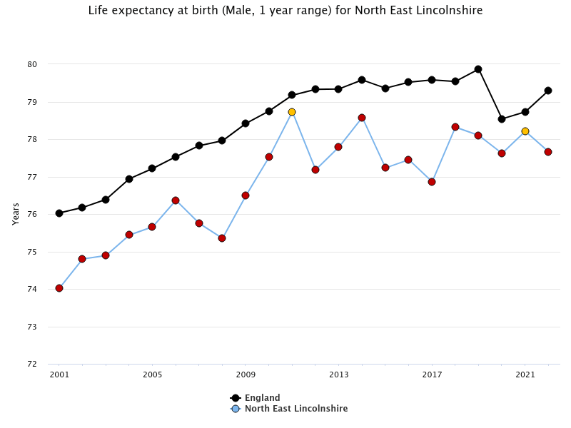
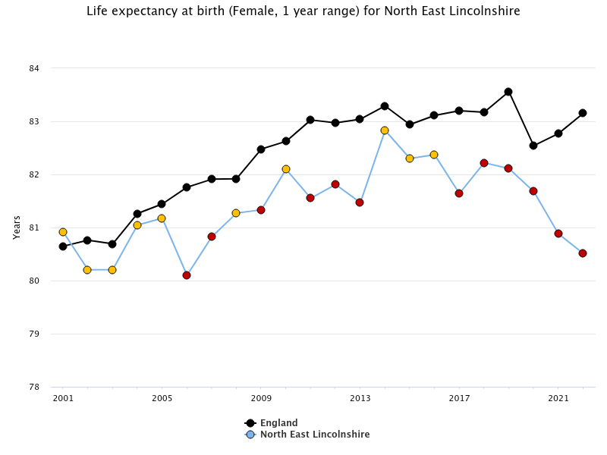
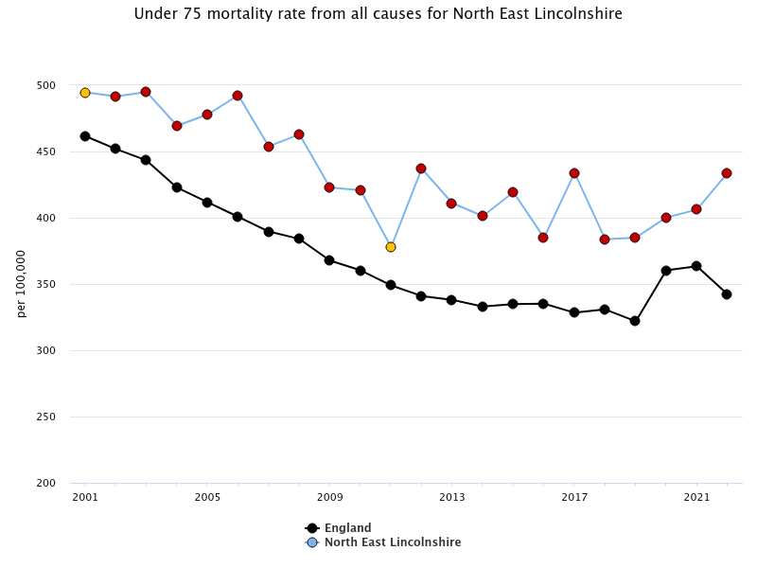
NEL LE at birth is below the England LE for each year over the past 20 years for both males and females.
The most recent data point shows LE at birth decreasing in NEL but increasing in England for both males and females.
Premature (<75 years) mortality is higher in NEL for all years compared to England.
Whilst NEL overall has significant health and social care needs, there are also stark health inequalities between different areas of the Borough.
Wider determinants, such as employment, housing, education, transport, and deprivation, all have a major influence on health and health inequalities.
Source: OHID

Slide 39
Life Expectancy in NEL
For such a small geographic area, we have an extremely wide variation in life expectancy across North East Lincolnshire. Males in East Marsh ward have a life expectancy at birth of just 70 years. Just a short journey to Humberston & New Waltham, Haverstoe, Wolds, and Scartho wards, and life expectancy increases up to 82 years, which is a life expectancy gap of 12 years in comparison to East Marsh ward.
A similar pattern exists for females, with a life expectancy of 76 years in East Marsh ward, compared to 86 years in Haverstoe ward, which is a life expectancy gap of a decade.
Male healthy life expectancy at birth is just 55 years in NEL with a deteriorating trend having decreased by 5 years over a 5 year period. Female healthy life expectancy is marginally better at 58 years. This has considerable implications for our workforce as a large proportion of people will be in poor health long before retirement age.

Slide 40
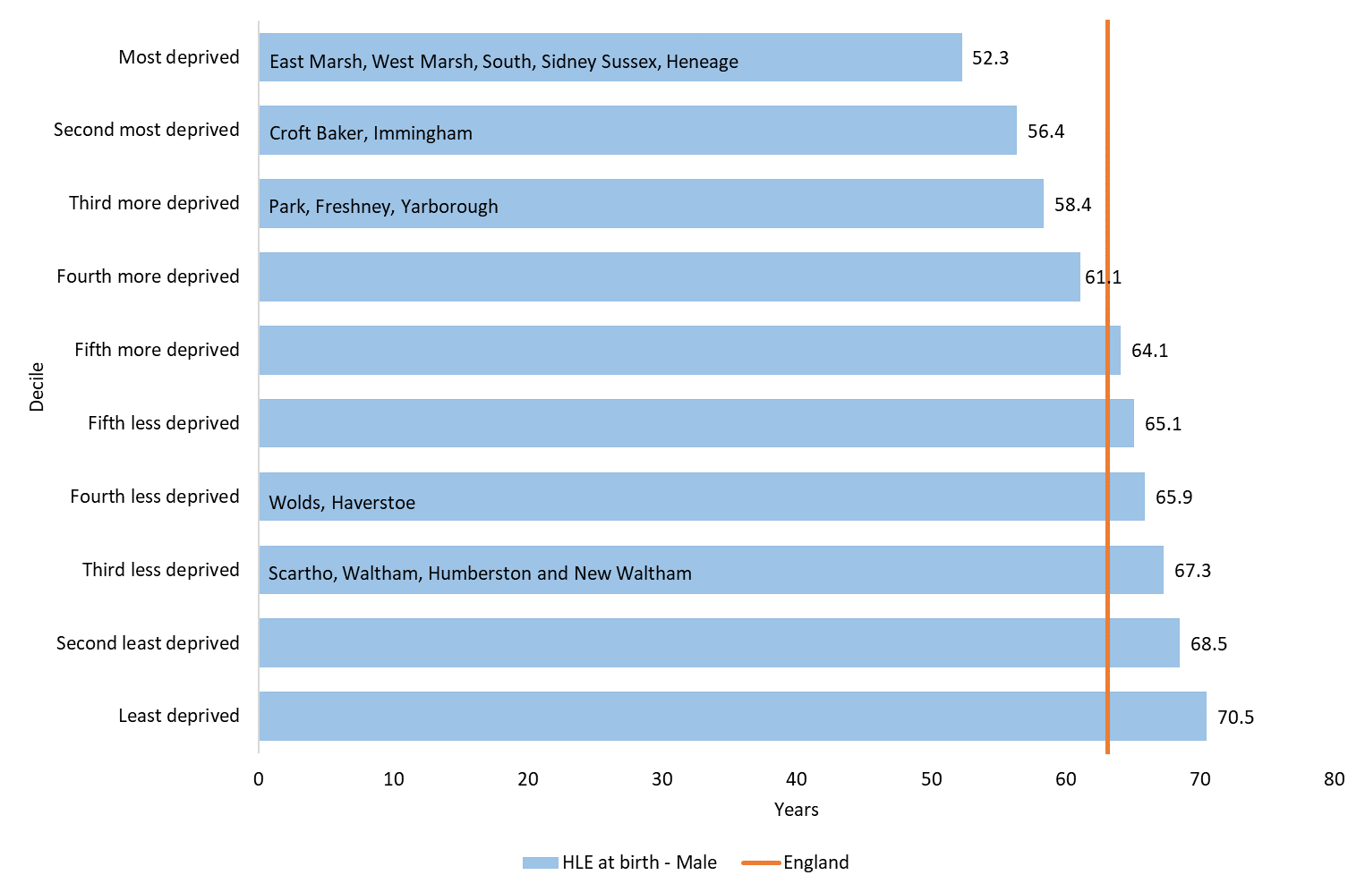
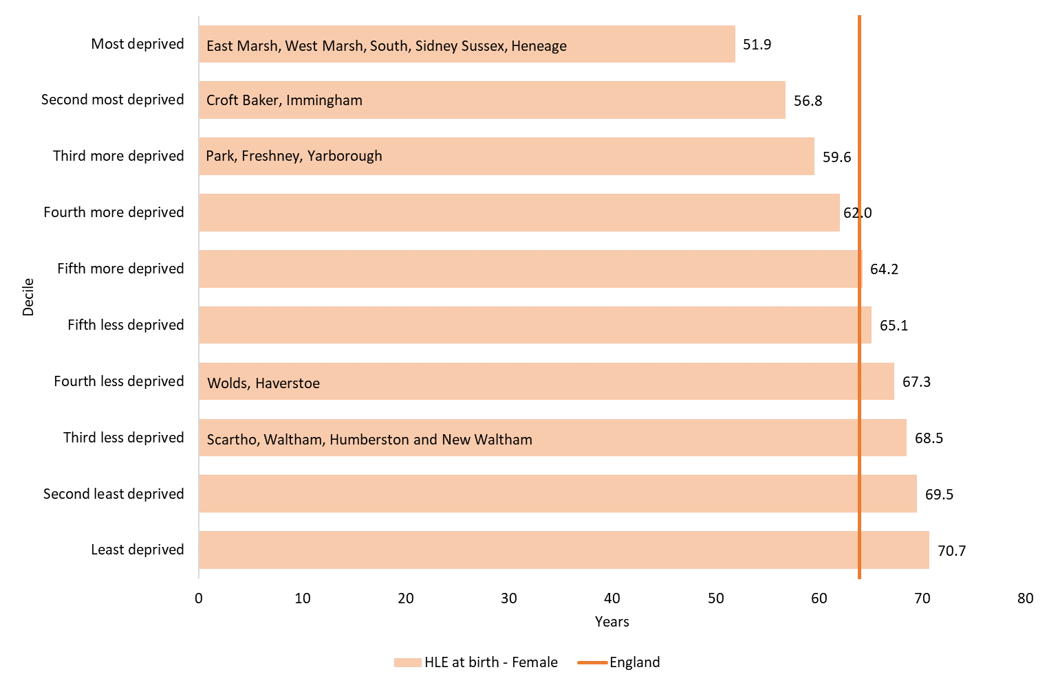
Healthy Life Expectancy in NEL
Healthy life expectancy figures for 2018-20 published by the ONS, show that there are considerable inequalities in healthy life expectancy between the most deprived and the most affluent areas in England.
Applying these figures to our local population, reveals a gap in healthy life expectancy between our most deprived wards and our most affluent wards, of 15 years in males and over 16 years in females.
In practice this means that many people in our most deprived communities are “old before their time” and many are unable to work, well before they reach the age of 65.

Slide 41
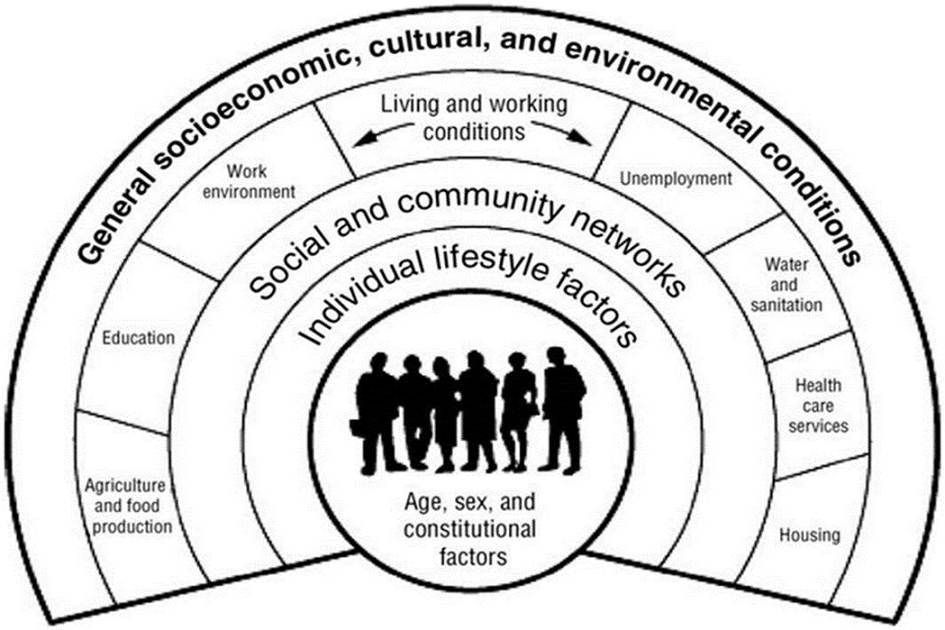
The Public Health Story – NL
Life expectancy has remained stable in NL over the last decade for both males and females.
The gap in life expectancy between people living in the most deprived areas and people living in the least deprived areas of NL has increased slightly for males (10.9-year gap) and decreased slightly for women (8.1-year gap).
These health inequalities in life expectancy are driven by wide disparities in cardiovascular disease, respiratory disease, cancer and in women dementia.
Male healthy life expectancy has remained relatively stable, yet female healthy life expectancy has dropped substantially between 2017-19 and 2018-20 – work planned to understand the causes of this reduction and act to improve healthy years of life.
Factors like low income, poor housing, inadequate education, lack of employment, lack of access to transport, and the surrounding environment in which someone lives, often restrict the choices that people have available to them.
These restricted choices can mean people lead unhealthier lives, which makes it vital to address the wider determinants of health.

Slide 42
The Public Health Story – NL
Most recent data shows that 36.6% of 11-year-olds are overweight or obese with major implications for lifelong health, and 71.7% of adults have excess weight (an increase from 2018).
The percentage of active adults, fell briefly during the pandemic and has since returned to pre-pandemic levels, whilst the percentage of inactive adults increased substantially during the pandemic and whilst it has since decreased it had not yet returned to pre-pandemic levels (Active Lives Survey, Sport England).
Our under 18 conception rate has recently increased, whilst the rate of abortion in under 18s remains low.
Whilst there have been large reductions, 12.1% of mothers are still smoking at time of delivery of their baby.
Our smoking prevalence in North Lincolnshire remains high, with our quit rates low
We have an ageing population in NL, with the rate of hip fractures in over 65’s high.
Our admissions for alcohol specific conditions in under 18s have reduced substantially, yet our admissions for substance misuse in those aged 15-24 have increased since 2016 (with a reduction in recent years)

Slide 43
The Public Health Story – NL
Major demographic challenges in the future due to rapidly increasing numbers of people over 80 (6,300 in the next 20 years). This will put social care services under enormous strain and is happening at a time when we are likely to see a falling working age population with minimal inward migration.
We will therefore need to find ways to support growing numbers of older people to remain living in their own home.
Healthcare services will also come under ever growing strain due to the ageing population and difficulties recruiting to a wide range of healthcare occupations in NL.
On the positive side we continue sustain high flue vaccination coverage in over 65s, with immunisation rates significantly above the national average. This is helping to ensure that infectious disease rates are low.
Notes:
Growing numbers of older people asset rich (e.g. big houses) but low income

Slide 44
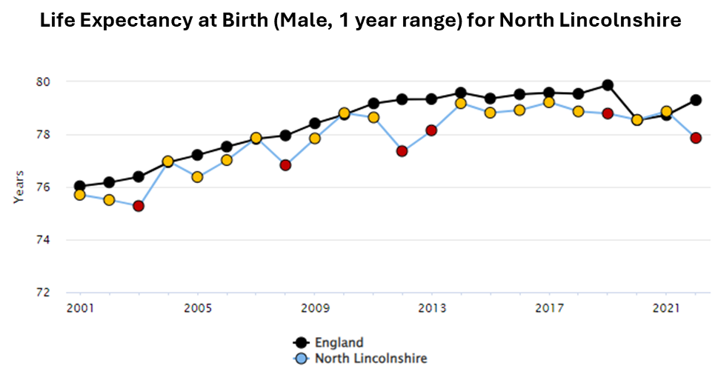
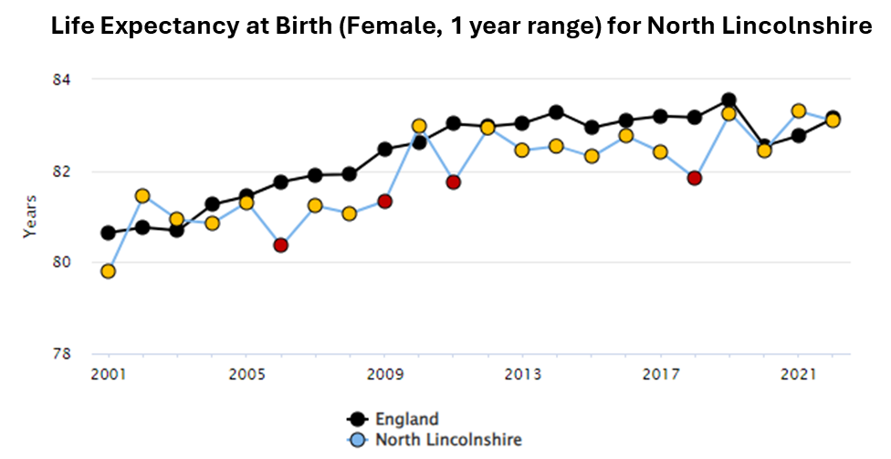
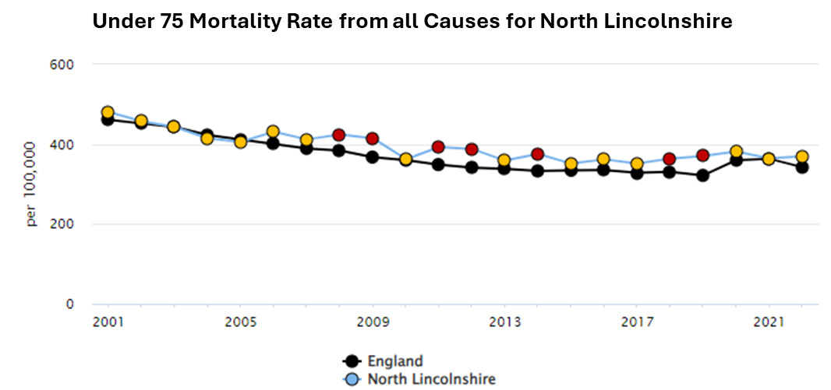
North Lincolnshire’s life expectancy at birth for males, in 2022, had reduced by 1 year since 2021, whilst the England average continues to show a rise.
North Lincolnshire’s life expectancy at birth for females has also shown a small decrease since 2021 but remains similar to the England average, which has increased.
All cause premature (under 75 years) mortality in North Lincolnshire has continued to remain stable and close to the England average.
Source: OHID

Slide 45
Life Expectancy at Birth, North Lincolnshire
Life expectancy at birth varies significantly across North Lincolnshire. This is shown to be the case in both males and females and when looking at life expectancy by ward.
There is a gap of 11.3 years between the highest and lowest life expectancy at birth in males. In Brumby ward, life expectancy is just 72.4 years, compared to 83.7 years in Axholme Central ward.
There is also a difference in life expectancy at birth in females with a difference of 9 years. Ashby Lakeside has the lowest life expectancy for females at 79.2 years, compared to 88.2 years in Axholme Central.

Slide 46
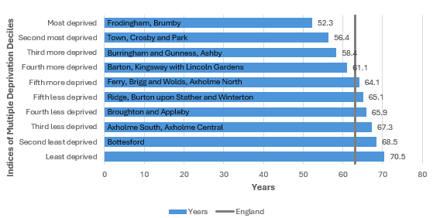
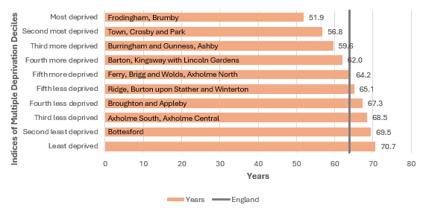
Healthy Life Expectancy, 2018-2020
Male Healthy Life Expectancy in England, 2018-2020 by Deprivation Decile
Healthy life expectancy is significantly impacted upon by health inequalities, with people living in the most deprived areas of the country having a significantly reduced healthy life expectancy than those who live in more affluent areas.
The healthy life expectancy figures for England in 2018-20, produced by the ONS, show a gap of 18.2 years in males and 18.8 years in females, between those living in the most and least deprived deciles.
Ward names have been included on these charts to provide an idea of how these inequalities might look in North Lincolnshire.
There are differences in how the national data and the local ward data have been scored. The deprivation deciles for England have been calculated based upon LSOA data which has been scored and ranked. This chart has been overlayed with unofficial ward data, calculated using the LSOA scores within the ward, to create a ward score, with the wards then ranked according to this. For this reason, it should be used with caution and as an indication only. North Lincolnshire wards included in this chart reflect the wards as they stood at the time the Indices of Multiple Deprivation was calculated in 2019.
Female Healthy Life Expectancy in England, 2018-2020 by Deprivation Decile

Slide 47
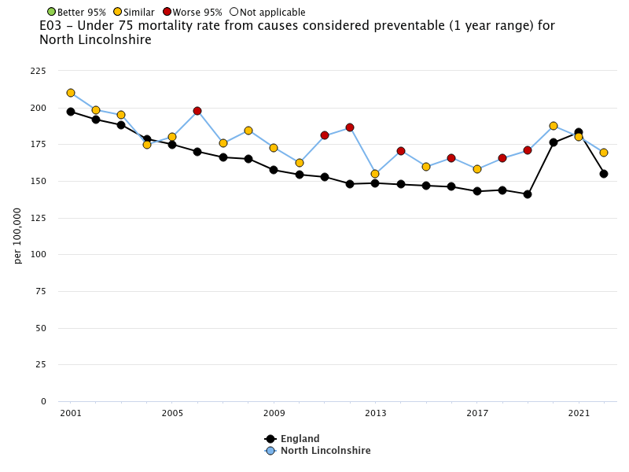
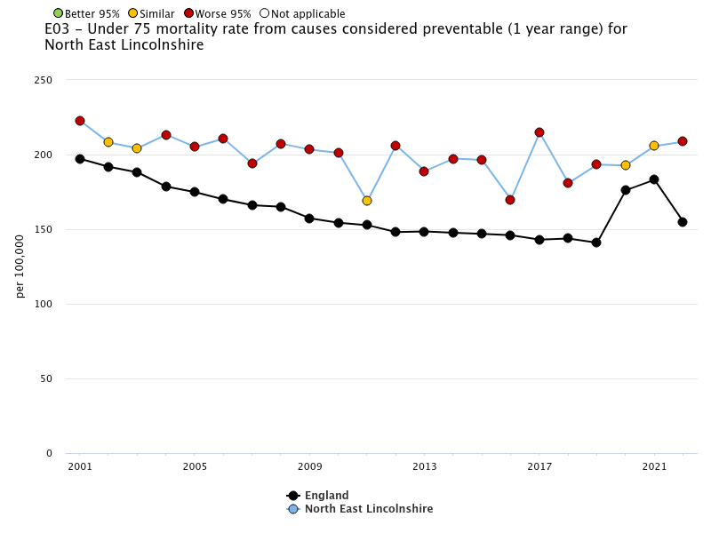
Under 75 mortality rate from causes considered preventable

Slide 48
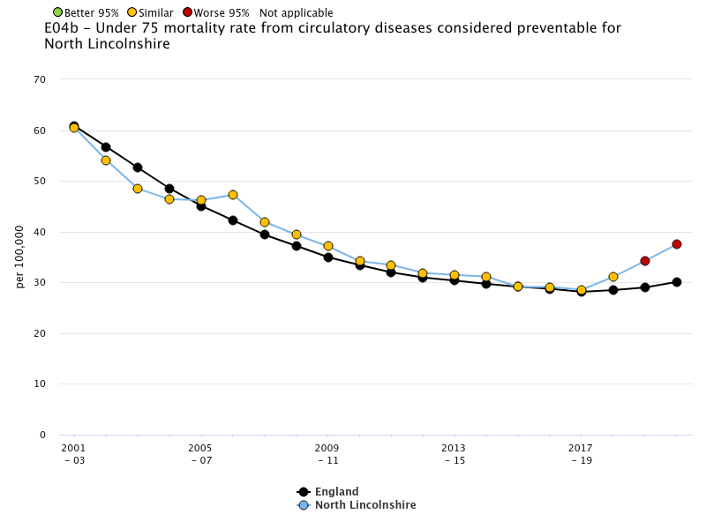
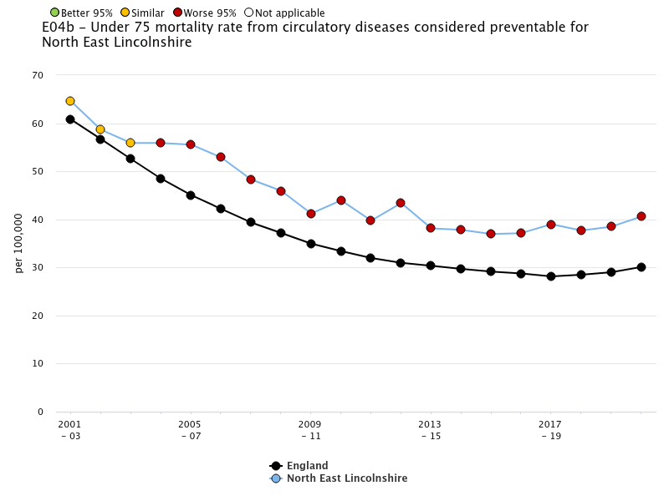
Under 75 mortality rate from all circulatory diseases considered preventable
Rate beginning to uptick again in both areas – higher than England average (NEL consistently so)

Slide 49
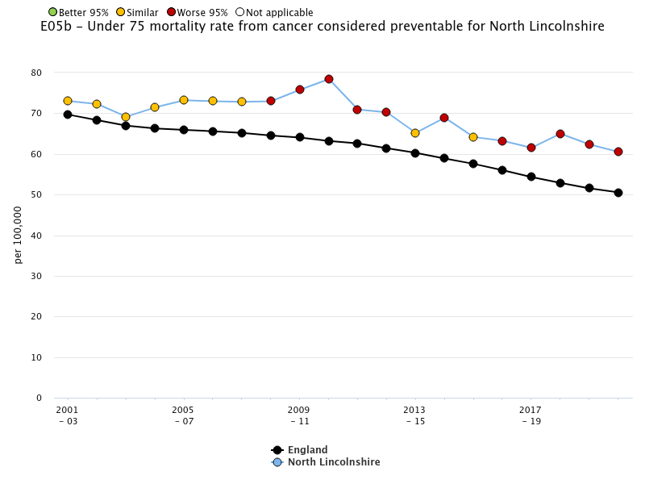
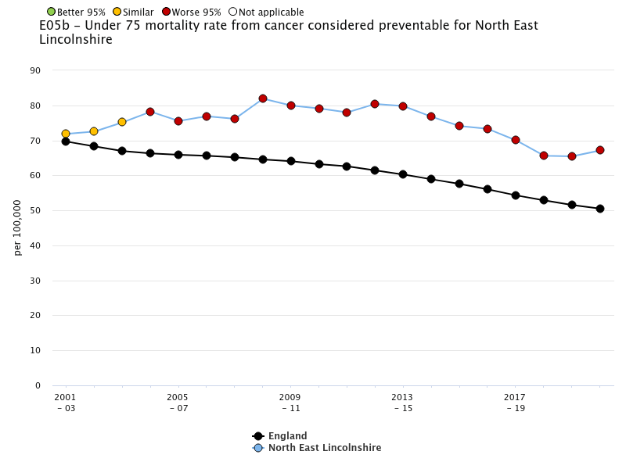
Under 75 mortality rate from all cancer considered preventable
Both areas consistently higher than England average

Slide 50
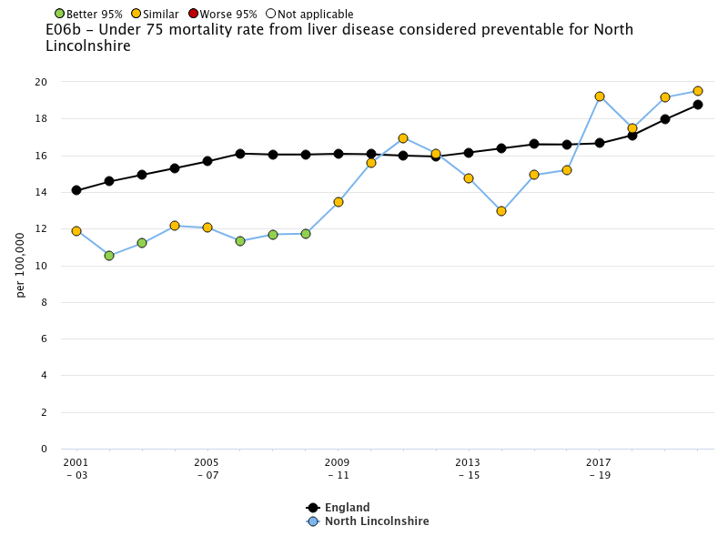
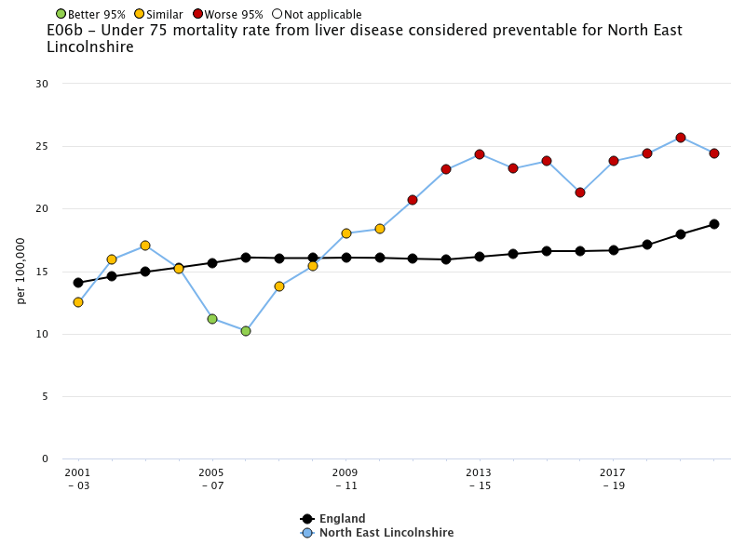
Under 75 mortality rate from all liver disease considered preventable
Under 75 mortality rates from preventable liver disease consistently increasing in both areas – renal will be a future challenge if we do not act now
NEL rate consistently higher than England average

Slide 51
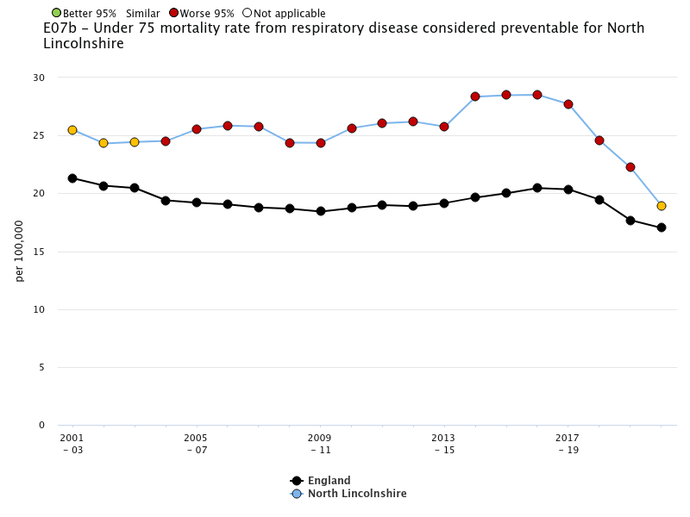
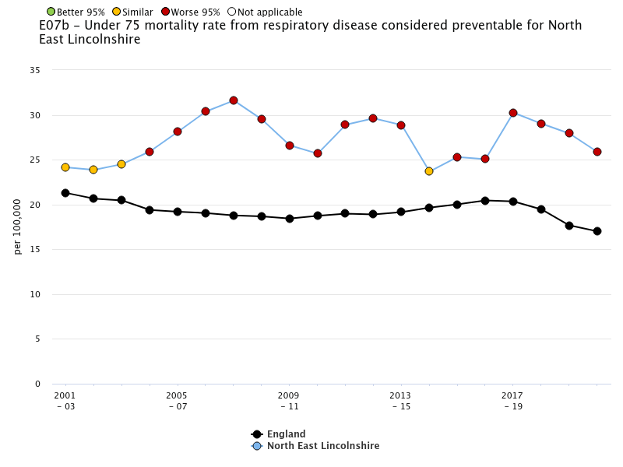
Under 75 mortality rate from all respiratory disease considered preventable
Both areas consistently higher than England average – NL similar in most recent data

Slide 52
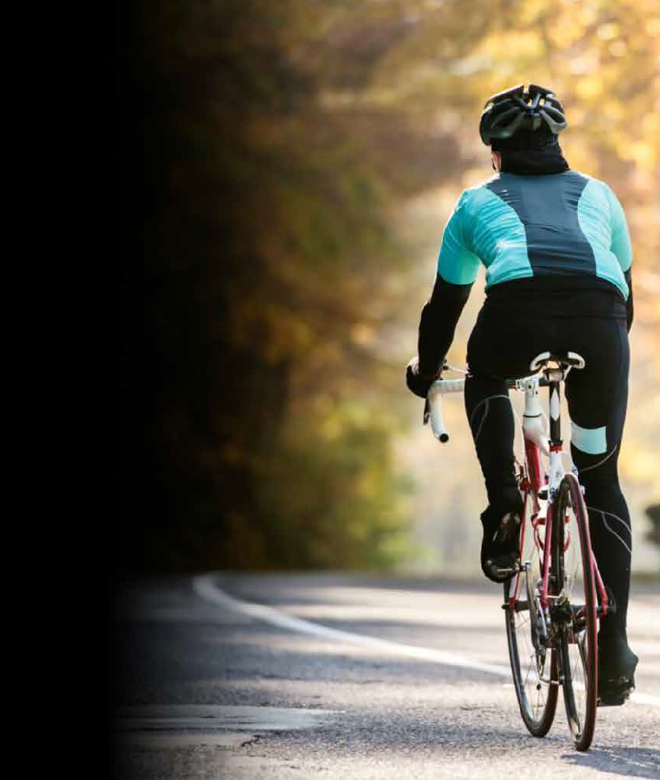
What contributes to our health
and wellbeing in Northern Lincolnshire?
The 2023 Northern Lincolnshire DPH report provides analysis into all the key levers to health in Northern Lincolnshire and those referenced by The Health Foundation including:
Friends, family & communities
The food we eat
Money and resources
Housing
Transport
Education and skills
Good Work
Our surroundings
Our ambition is to make public health everyone’s business across Northern Lincolnshire and to enable and empower everyone to be a public health leader.
Diane Lee
Diane Lee
Director of Public Health, Northern Lincolnshire
Rural Road in North East Lincolnshire
Notes:
Each chapter in the report focusses on 'what makes us healthy’:
(list)
And each chapter has at least 1 strategic recommendation which we will deliver over the next 12 months – summarise at the end.
Key point: I would like to use this report as the foundations for the work of the Health and Wellbeing Board moving forward and for the focus on a revised health and wellbeing strategy.

Slide 53
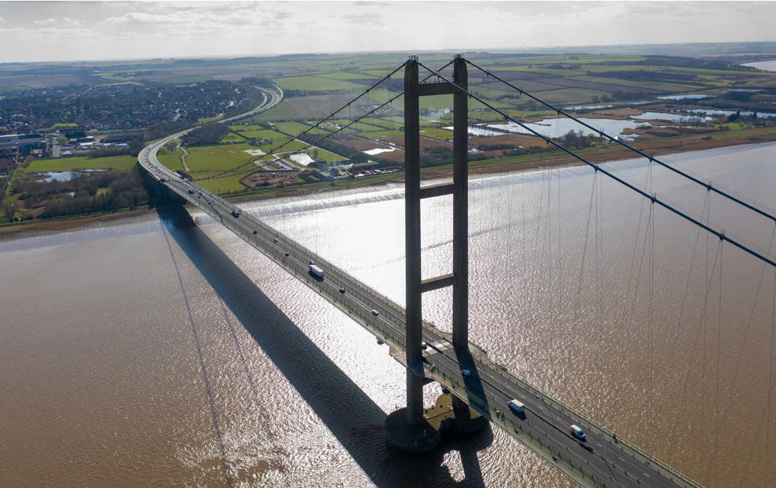
RECOMMENDATIONS
FAMILIES, FRIENDS AND COMMUNITIES
Explore localised approaches that allows families and friends to connect and support each other to make healthy choices.
Continue to support community spaces and Voluntary Community Sector (VCS) enabled networks, across Northern Lincolnshire, to counter isolation.
FOOD WE EAT
Explore how we can support those residents and families in need with healthy food, ideas and training.
Work with our colleagues to ensure the health and wellbeing of the residents of Northern Lincolnshire are at the forefront of decision making regarding future developments.
MONEY AND RESOURCES
Ensure those families who are eligible to access Free School Meals are automatically enrolled, meaning no family misses out.
Explore how we can support those families in need with healthy food, ideas and training.
Promote breastfeeding as a healthy and cost-effective choice.
HOUSING
Work in partnership with key council departments and housing partners to ensure support and training to Make Every Contact Count available to those working with residents with the greatest health inequalities.
TRANSPORT
Be champions of Active Travel, reducing car journeys and improving air quality.
EDUCATION AND SKILLS
Work with schools and other key agencies to enhance key prevention work for children and young people, including developing health literacy, improving oral health and building resilience.
GOOD WORK AMBITIONS
Continue to support workplaces to reward their efforts and achievements in building a healthy workforce, a healthy workplace and a healthy organisation.
Work with services supporting those who are unemployed with key training and support in mental health and suicide prevention.
SURROUNDINGS
Work with our colleagues to ensure the health and wellbeing of the residents of Northern Lincolnshire are at the forefront of decision making regarding future developments.
Explore innovative public health programmes to continue to make our neighbourhoods healthy, safe, fun and active.

Slide 54
Existing collaborative public health initiatives with NLAG
SATOD- working closely with NLaG Tobacco Dependency Advisor Team Leader to explore the data and the regular audits completed in terms of Saving Babies Lives Care Bundle (v3).
NLag midwifery representation at Northern Lincolnshire Tobacco Alliance
0-19 Health and Wellbeing Service works closely with NLaG Midwifery to facilitate A/N and New Baby visits by Health visitors.

Slide 55
Collaboration with NLaG
The oral health promotion service is provided by NLaG, this is led by a steering group consisting of PH leads, consultant in PH, consultant in dental PH and service leads​
NLAG and PH works in partnership on the delivery of the fluoride varnishing pilot programme in areas of high need​.
NLaG community inclusion nursing team works closely with our substance misuse service and NLC homelessness team to provide support to homeless and rough sleepers

Slide 56
The art of the possible
Public Health and NLaG working together

Slide 57
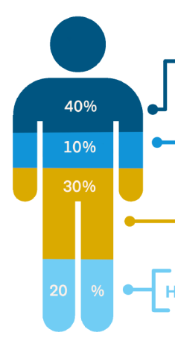




Learning from others: Barnsley Hospitals NHS Foundation Trust
Create a strategy and action plan
Tier 1. By establishing new services in partnership, we will prevent the onset, progression and impacts of disease through early intervention, narrowing the inequality gap in the healthy life expectancy of the North Lincolnshire population.
1
2
Tier 2. By enhancing existing services, we will reduce inequalities in access to care, and address disparities in patients’ experience of care to improve patient outcomes.
Tier 3. By harnessing the Trust’s role as an anchor institution to help build a more inclusive society and economy in North Lincolnshire, we will help to address inequalities in the wider determinants of health. We will influence these social, economic and environmental factors to improve population health.
3

Slide 58
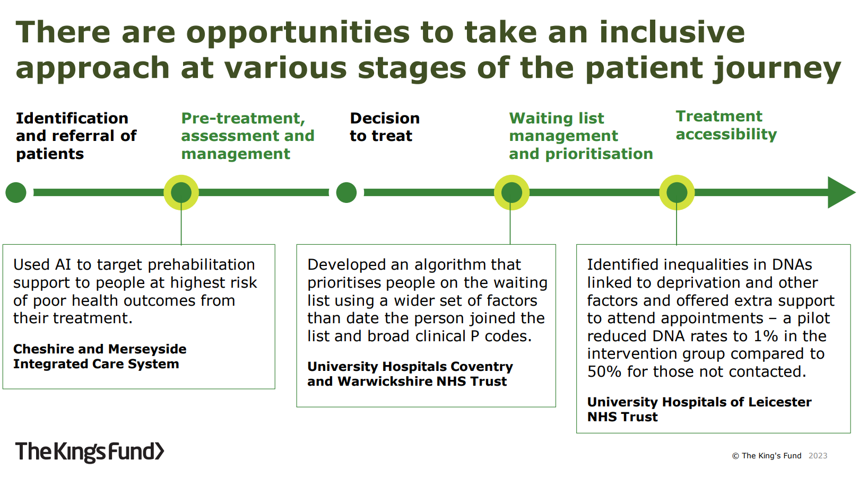

Slide 59
Suggested way forward
Meeting between Nick Cross, Diane Lee, and both senior teams
Discussion/decisions made regarding:
Adoption/shaping of broad-scope framework (the three tears)
Development of supporting action plan
Development of leadership and governance
Potential for dedicated public health consultant leadership working across both organisations
Potential for registrar post based at NLaG

Slide 60
Governor elections
Alison Hurley
Deputy Director of Assurance

Slide 61
Seats for Election
Constituencies and Number of Seats Available:
East and West Lindsey 1 seat
Goole and Howdenshire 3 seats
North East Lincolnshire 1 seat
North Lincolnshire 2 seats
Staff 2 seats

Slide 62
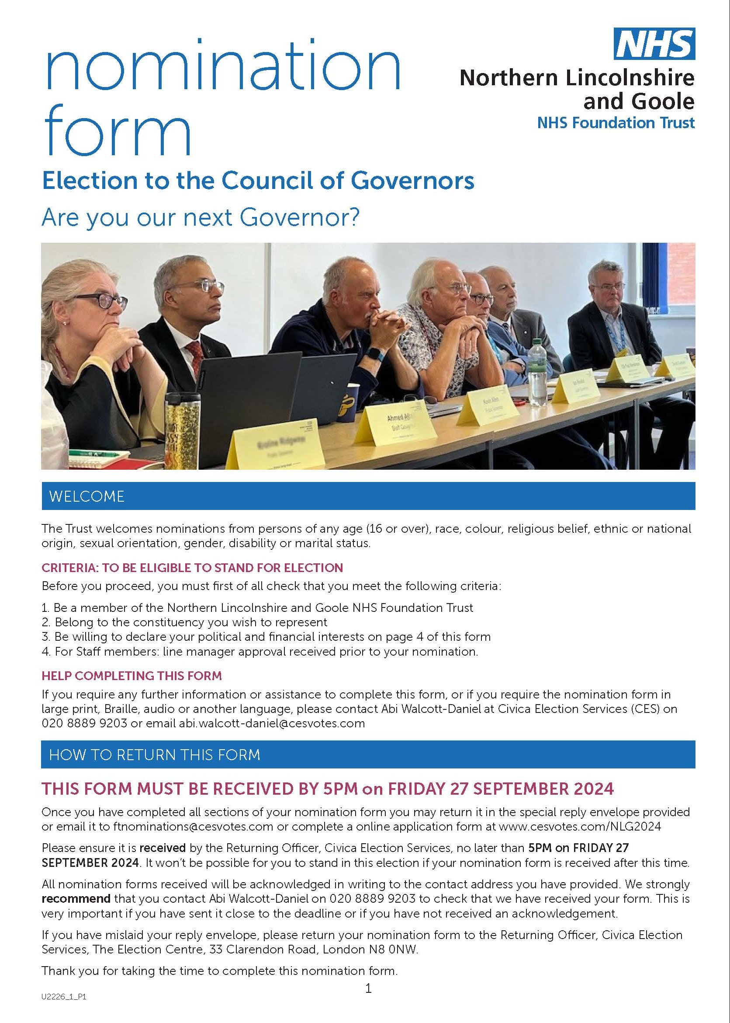
Elections Timetable
Notice of Election 5th September 2024
Close of Nominations 27th September 2024
Last date for Withdrawal 2nd October 2024
Ballot starts 18th October 2024
Close of Ballot 5pm 13th November 2024
Declaration of Result 14th November 2024

Slide 63
For further information please contact:
Corporate Assurance Team
03033 302852
Nlg-tr.foundationtrustoffice@nhs.net
Compassion Honesty Respect Teamwork

Slide 64
Final thoughts
Sean Lyons
Chair

