Slide 1

Hull University Teaching Hospitals NHS Trust Annual General Meeting and Northern Lincolnshire and Goole NHS Foundation Trust Annual Members Meeting
Wednesday 22 October 2025

Slide 2
Welcome everyone
Lyn Simpson,
Interim Group Chief Executive
Commenced 28 July 2025

Slide 3
A timeline of Recent and Current National Events
Summer 2024
General Election
Lord Darzi report on the state of the NHS
Autumn 2024
Public consultation portal for 10 Year Health Plan opened
Wes Streeting announces plan for ‘hospital scorecards’
Spring 2025
Jim Mackay appointed CEO of NHSE
Reduction in ICB running costs by 50% and NHSE abolition announced.
Summer 2025
Autumn 2025
NHS 10 Year Health Plan published, with planned shift from hospital to community
New National Oversight Framework details published (hospital scorecard)
NHS national oversight results published
National meeting for all Trust CEOs with Jim Mackay

Slide 4
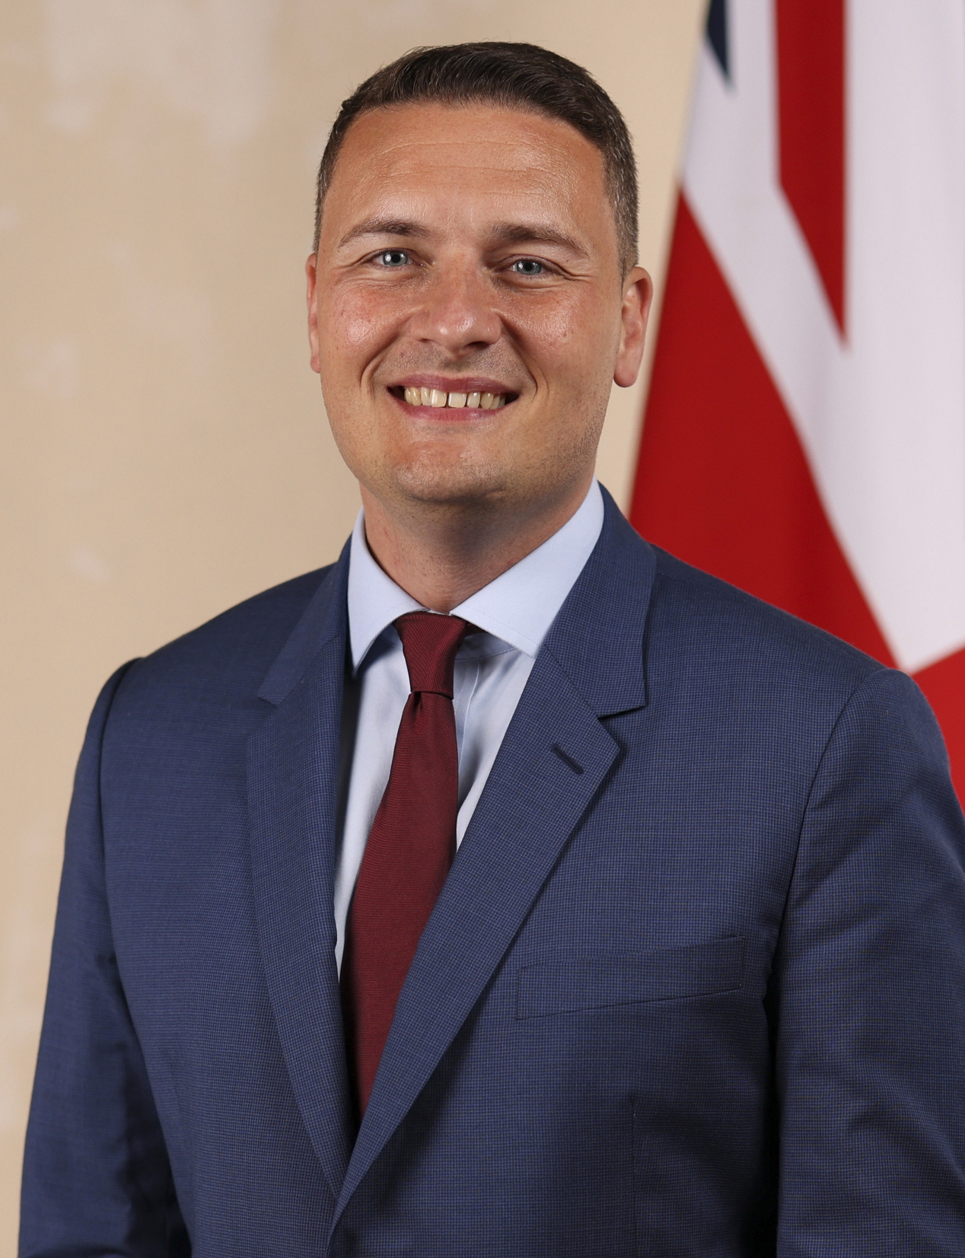
Secretary of State's key messages
Stay the course – our leadership is being noticed and valued nationally
Credibility counts – grip on money gives us influence with Government
10-Year Health Plan – real energy for reform, and recognition that change is needed: hospital to community, sickness to prevention, analogue to digital
Delivery matters – expectations are high, but confidence in us is growing
Industrial action – no change, but commitment to finding a way through
Maternity – listen to families, simplify regulation, restore common sense
Mental Health – pressure for further investment is being heard
Abuse and discrimination – zero tolerance; protect colleagues and live NHS values

Slide 5
National priorities for the NHS in the rest of 2025/26
Look after our resources and don’t spend more than we have – so we can protect patient care where it matters most
Focus on what matters for patients – reduce elective and cancer waits, and improve urgent care flow
Prepare together for winter – supporting each other through the hardest months
Shape the future, not just the present – start bringing the 10-Year Plan to life locally
Work differently, not harder – continue to develop new ways of working that add value for patients
Stand together under pressure – stay resilient and consistent in tough times
Lead with integrity and compassion – our NHS colleagues and communities are watching how we show up to work each day

Slide 6

A year of transition for NLaG and HUTH
Launched new operational structure in April 2024 – a joint management approach with 14 Care Groups across the two organisations
NLaG and HUTH agreed to work under the name NHS Humber Health Partnership
Opened Community Diagnostic Units across the region in Hull, Grimsby and Scunthorpe
Began a review of services provided at Goole hospital
Changes in leadership including at chief executive and chair level – thank you to Sean Lyons for his four years of service as Chair and to Amanda Stanford for stepping up as interim CEO
Thanks to all of our staff, partners, and volunteers who have worked so hard throughout this period of change

Slide 7
Group performance
Performance against our main constitutional targets is not where it needs to be.
Neither NLaG or HUTH is achieving against our most important patient access targets:
A&E 4-hr target/ambulance turnaround time
Cancer waiting times
Referral to treatment times for planned surgery
Our annual reports cover our performance in detail

Slide 8
Group finances
The Group reported a break-even position for the 2024/25 financial year
The Group delivered £84.2 million of cost savings against a target of £84.6 million. However, this figure was heavily reliant on non-recurrent savings of £61.5 million.
Group capital spend was £84.3 million across the financial year. £0.7 million behind the agreed annual plan.
The Group over-delivered against Elective Recovery Fund targets at 101.7%, £4.7 million ahead of plan.

Slide 9
The New NHS Scorecard: What It Means for Patients
A good or improving scorecard means patients are being seen sooner, receiving safer and more timely care, colleagues are better supported to do their jobs and taxpayers are receiving good value for money
Looks at how well each Trust is doing through a shorter set of measures
Designed to spot risks early and make sure patients are safe and cared for in the right way
Scores based on safety, timeliness of care, workforce culture, and value for money
Called the National Oversight Framework (NOF)
Ranks each Trust from 1 to 4 – with very challenged trusts ranked as 5

Slide 10
Our first set of ratings
 | NLAG
 | NOF 1 | NOF 2 | NOF 3 | NOF 4 | Overall Score
Access to Care Services |  | 2 | 2 | 4 | 3.26
Effectiveness & Experience of Care | 1 | 3 |  |  | 1.84
Patient Safety |  |  | 2 | 2 | 3.51
People & Workforce |  |  | 2 | 1 | 3.36
Finance & Productivity |  |  | 1 | 1 | 2.76
Total | 1 | 5 | 7 | 8 | Segment 4
 | HUTH
 | NOF 1 | NOF 2 | NOF 3 | NOF 4 | Overall Score
Access to Care Services |  |  | 5 | 2 | 3.15
Effectiveness & Experience of Care |  | 4 |  |  | 1.97
Patient Safety |  | 1 |  | 3 | 3.53
People & Workforce | 1 |  | 1 | 1 | 2.51
Finance & Productivity |  |  | 2 |  | 3.27
Total | 1 | 5 | 8 | 6 | Segment 4

Slide 11
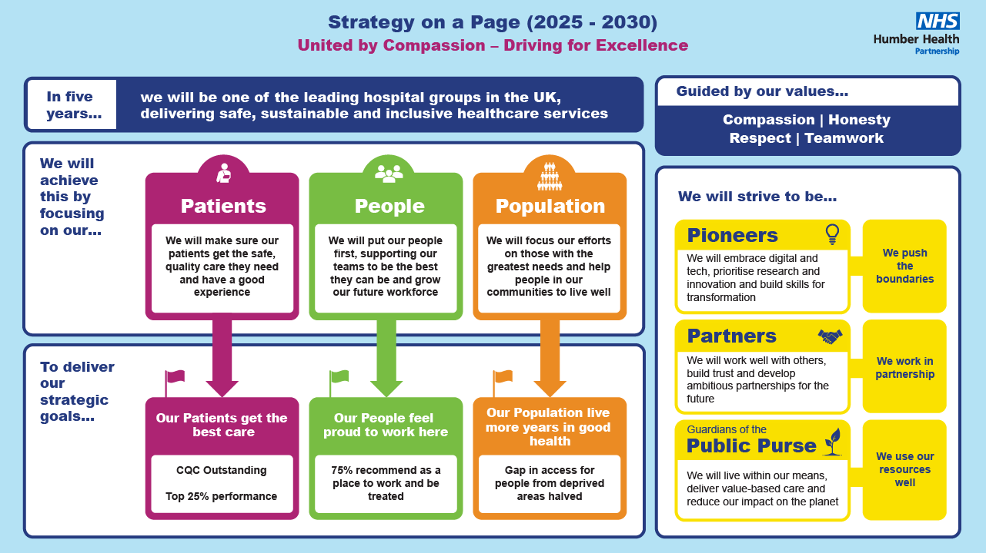
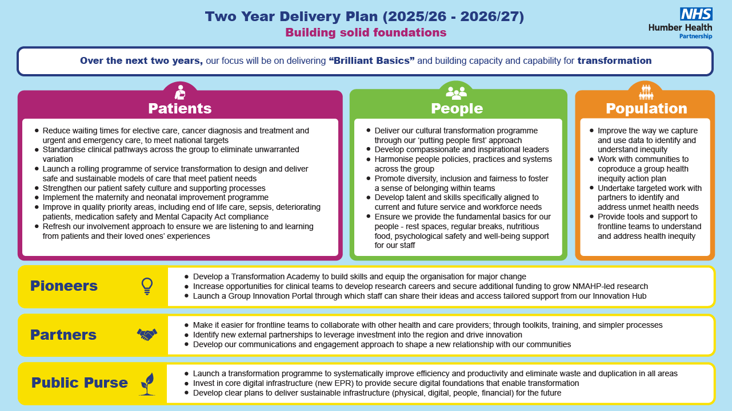

Slide 12
My key priorities for 2025/26
Improve performance against the patient access targets:
Patient flow - emergency care performance and ambulance handovers, cancer and elective waiting lists reduction
Deliver the financial plan
Improve the working culture for staff and engage our clinicians in the decision-making process
Look after the wellbeing of our people

Slide 13
My key priorities for 2025/26
Focus on getting some of the basics right – patient safety and experience - hellomynameis , IPC adherence, ‘knowing’ our patients and their loved ones and understanding what they need
Procure a new group-wide Electronic Patient Record system – key enabler in transforming clinical pathways and improving efficient care delivery
Conclude the review of Goole population health needs and look to expand those services residents need and use the most

Slide 14
My reflections in summary
We will listen to our patients and their loved ones and we can improve over the next 12 months
Engaging our clinicians and involving them in decision-making is vital to our improvement
Improving our NHS league table performance will help us to thrive as an organisation
We have a lot of extremely good staff and services
Disappointed that we are not delivering for our patients in terms of access to services
We will find a way to enable and empower our people to transform our services

Slide 15
Thank you
Questions?

Slide 16
Hull University Teaching Hospitals NHS Trust – Financial Performance Review 2024/25
Emma Sayner
Group Chief Financial Officer

Slide 17
Independent auditor's report to the Directors of Hull University Teaching Hospitals NHS Trust
“In our opinion, the financial statements:
…give a give a true and fair view of the financial position of the Trust as at 31 March 2025 and of its income and expenditure for the year then ended;
…have been properly prepared in accordance with the Department of Health and Social Care Group Accounting Manual 2024/25; and
…have been properly prepared in accordance with the requirements of the National Health Service Act 2006. “.

Slide 18
The Trust achieved its control total in 2024/25, which was to deliver a breakeven position or better:
 | £’000s
Deficit as per accounts | (10,304)
Remove impairments | 11,775
Remove grants and donation impact | 26
Covid-19 inventories | 191
Sub Total | 1,688
Remove PFI revenue costs on an IFRS basis | 12,529
Add back PFI revenue costs on a UK GAAP basis | (14,206)
Adjusted Financial Position surplus / (deficit) | 11
Control Total | 0
Improvement on control total | 11

Slide 19
FINANCIAL REGIME 2024/25
Block funding continued for non-elective and emergency care– with inflationary uplifts. Planned care, in the main, continued to have variable components based on the Elective Recovery financial framework to incentivise elective activity levels above the 2019/20 baseline.
A fixed envelope for Covid costs within the Block payment, but significantly lower than previous years.
Pass through funding for NHSE high cost drugs & devices

Slide 20
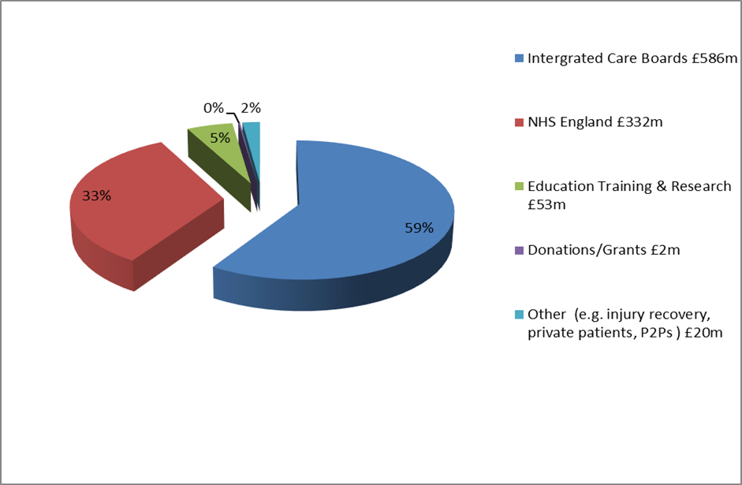
WHERE OUR MONEY CAME FROM
Our operating income in 2024/25 was £993m, as shown below:

Slide 21
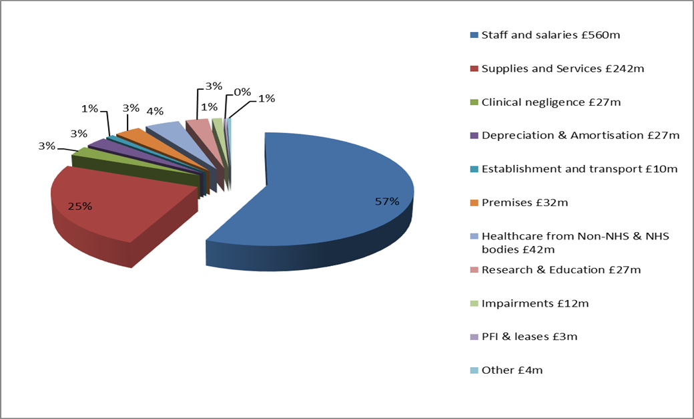
HOW WE SPENT OUR MONEY
Our operating expenditure in 2024/25 was £987m, as shown below:

Slide 22
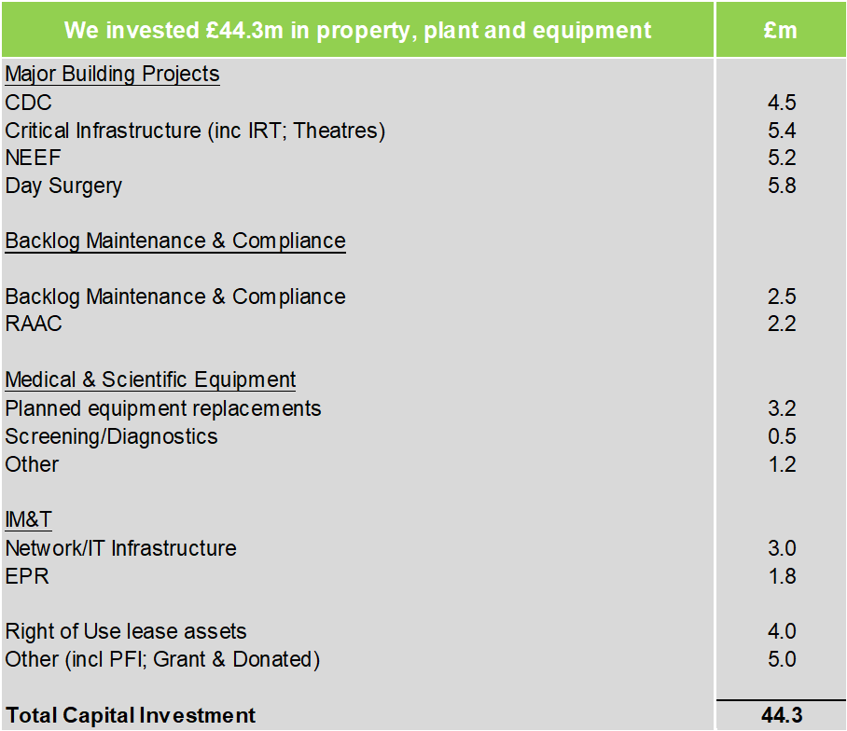
INVESTMENT IN INFRASTRUCTURE

Slide 23
BALANCE SHEET STRENGTH
In overall terms the main changes on the Trust’s Balance Sheet reflect the following:
Non Current Assets increased by £18m – mainly the impact of extensive capital programme and the inclusion of Right of Use assets under the new IFRS16 lease guidance.
Cash and cash equivalents have decreased from £37.5m to £34.9m mainly due to receivables increasing.
Borrowings have decreased from £85.7m to £84.7m which reflects the in-year payments on capital loans and PFI unitary payments.
Performance against the Public Sector Payment Policy remained high at almost 86.5% by volume for our Non NHS Suppliers and at 87% for NHS Suppliers.

Slide 24
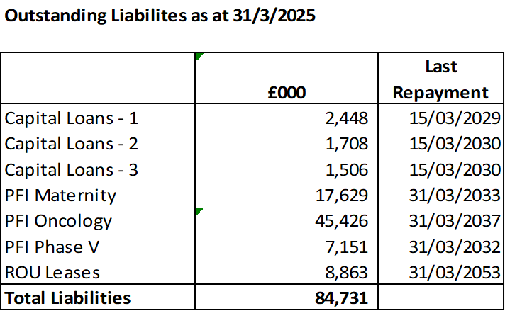
BORROWING POSITION 2024-25

Slide 25
2025/26….
The Trust agreed a breakeven plan for 2025/26, which included continued receipt of £13.2m deficit support funding as well as additional non recurrent income from the ICB of £25m.
This was part of an overall balanced financial plan across the Humber Health Partnership and the Humber & North Yorkshire ICB.
In order to deliver the balanced financial plan, the system needs to deliver £294.9m in Cost Improvements. The Trust’s contribution to this is a requirement to deliver £68.3m Cost Improvement Plans (CIP) to achieve its planned break-even financial plan.
The Trust has a capital programme of £78.2m (as at Oct 2025), dominated largely by critical infrastructure schemes, including theatres upgrades. Other major capital schemes are related to national funding for expanding SDEC facilities to address constitutional standards and funding for energy efficiency schemes. Investment in IM&T projects is significant this year due to the procurement of the new Electronic Patient Record. Other schemes relate to the backlog maintenance/replacement IT and equipment programmes

Slide 26
Looking ahead: underlying financial position
The Trust exited 2024/25 with an underlying recurrent deficit assessed at circa £75m.
Following release from NHSE of further guidance on the treatment of specific funding flows this position has improved to (£42.9m) as at September 2025.
The main drivers of the underlying position are:
Deficit Support funding – (£14.2m)
Non recurrent savings delivery – (£20.5m)
Non recurrent funding support – (£25.6m)
FYE of 2025/26 savings delivery - £22.4m
NR Flexibility – (5.1m)

Slide 27
Northern Lincolnshire and Goole NHS Foundation Trust – Financial Performance Review 2024/25
Emma Sayner
Group Chief Financial Officer

Slide 28
Independent Auditor's report to the Council of Governors of Northern Lincolnshire and Goole NHS Foundation Trust
“In our opinion, the financial statements:
…give a true and fair view of the financial position of Northern Lincolnshire and Goole NHS Foundation Trust as at 31 March 2025 and of its expenditure and income for the year then ended;
…have been properly prepared in accordance with the Department of Health and Social Care Group Accounting Manual 2024-25; and
…have been prepared in accordance with the National Health Service Act 2006.”

Slide 29
The Trust achieved its control total in 2024/25, which was to deliver a breakeven position or better:
 | £’000s
Deficit as per accounts | (13,471)
Remove impairments | 15,545
Remove grants and donation impact | (2,073)
Adjusted Financial Position surplus / (deficit) | 1
Control Total | 0
Improvement on control total | 1

Slide 30
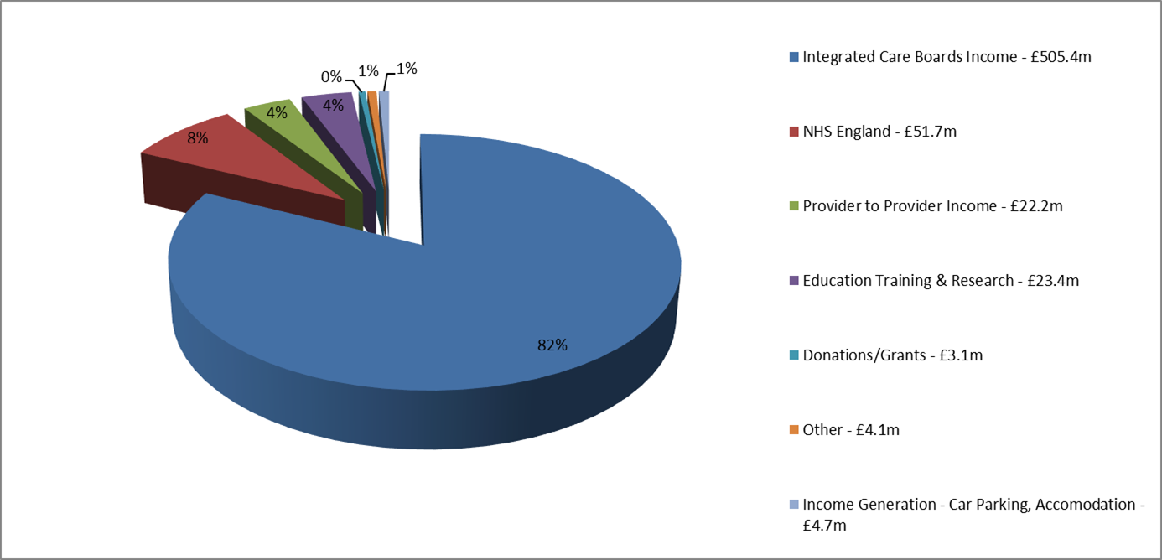
WHERE OUR MONEY CAME FROM
Our operating income in 2024/25 was £615m, as shown below:

Slide 31
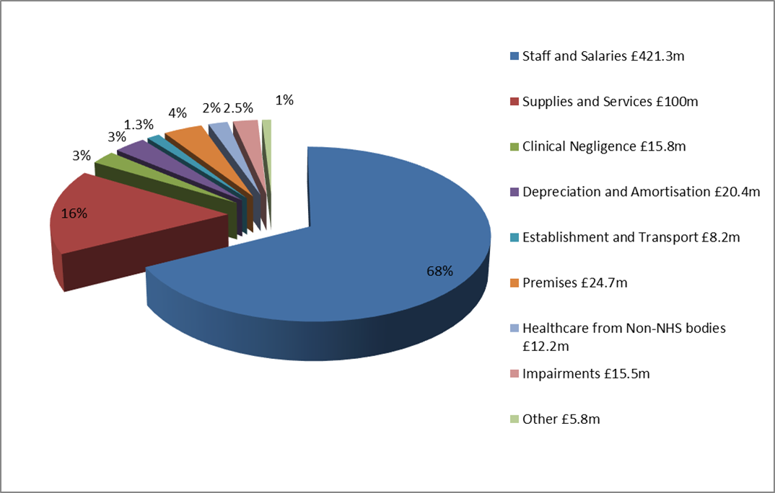
HOW WE SPENT OUR MONEY
Our operating expenditure in 2024/25 was £624m, as shown below:

Slide 32
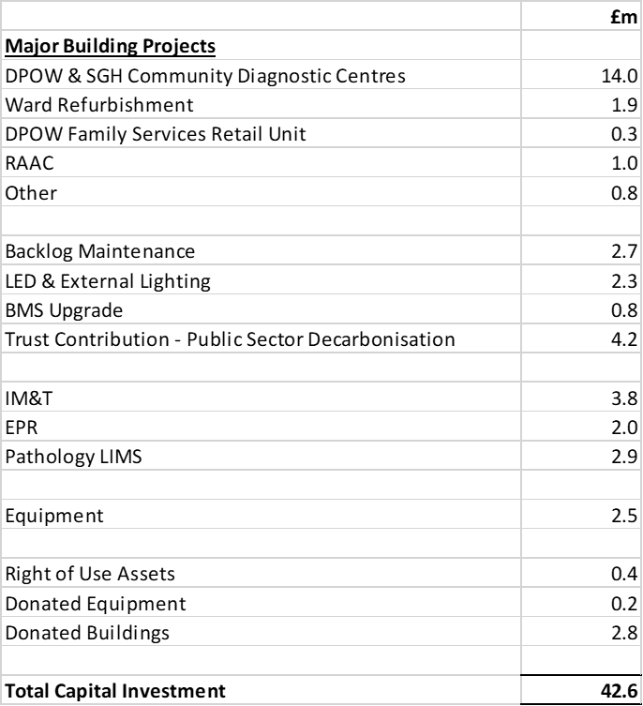
INVESTMENT IN INFRASTRUCTURE
We invested £42.6m in property, plant and equipment

Slide 33
BALANCE SHEET STRENGTH
In overall terms the main changes on the Trust’s Balance Sheet reflect the following:
Non Current Assets increased by £6.5m – as a result of the capital spend in year, less depreciation and impairments.
Cash and cash equivalents have decreased to £32.7m reflecting the in-year deficit.
Borrowings – loans have reduced from £6.9m to £5.6m, which reflects the in-year payments on capital loans. Lease liabilities have reduced to £10.9m as a result of payments in year and remeasurements.
Performance against the Public Sector Payment Policy remained high during the year, the value of invoices paid for our Non NHS Suppliers was 95.8% and 93.9% for NHS Suppliers.

Slide 34
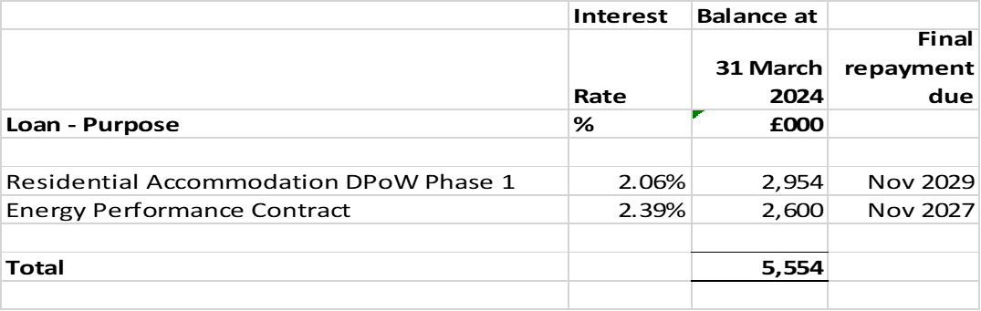
BORROWING POSITION 2024-25
Capital loans outstanding at March 25 were £5.6m.
The details are below:

Slide 35
2025/26….
The Trust agreed a balanced financial plan for 2025/26 financial year but is reliant on non-recurrent deficit support funding of £14.9m.
This was part of an overall balanced financial plan across the Humber Health Partnership and the Humber & North Yorkshire ICB.
In order to deliver the balanced financial plan, the system needs to deliver £294.9m in Cost Improvements. The Trust’s contribution to this is a requirement to deliver £61.7m Cost Improvement Plans (CIP) to achieve its planned break-even financial plan.
The Trust has a capital allocation as at September 2025 of £66.2m, dominated largely by Electronic Patient Record (EPR) £15.8m, Humber Acute Services (HAS) infrastructure enabler £3.4m, Estates Safety £5.8m, NEEF 4 PV funding £2.4m and Public Sector Decarbonisation schemes £19.1m.

Slide 36
Looking ahead: underlying financial position
The Trust exited 2024/25 with an underlying recurrent deficit assessed at circa £51.3m.
Following release from NHSE of further guidance on the treatment of specific funding flows this position has improved to (£31.2m) as at September 2025.
The main drivers of the underlying position are:
Deficit Support funding – (£14.9m)
Non recurrent savings delivery – (£22.7m)
Non recurrent funding support – (£1.4m)
FYE of 2025/26 savings delivery £7.7m

Slide 37
HHP Group: Key Financial Risks
Delivery of the Group’s financial plan is considered extremely high risk.
The magnitude of the efficiency plan is clearly the most challenging aspect within this. Development of the efficiency programs is being managed through the Financial Planning Improvement Board. Within the evolving efficiency programme, the largest risks are:
As at Month 6, the Group still has £15.7m of unidentified CIP and less than half the year to identify and deliver this efficiency requirement.
Delivery of additional elective activity through productivity gains, including the conversion of follow-up out-patient activity to new first appointments to improve waiting times performance.
Delivery of length of stay reductions of our acute patients, particularly improvements to reduce the length of stay for those patients with no criteria to reside.
Delivery of ambitious targets to reduce agency and non-contractual pay and convert ‘bad cost to good cost’.
Finally, the cash management associated with the financial plan is a risk given the reliance on the efficiency plan for reducing costs and will need tight management of our working capital – with potential need for cash support in year.
Delivery of such an ambitious efficiency programme requires a complete change in mindset from all of our teams as well as from our system partners. This change in culture and the need to embrace transformation is key to successfully delivering our financial plans.

Slide 38

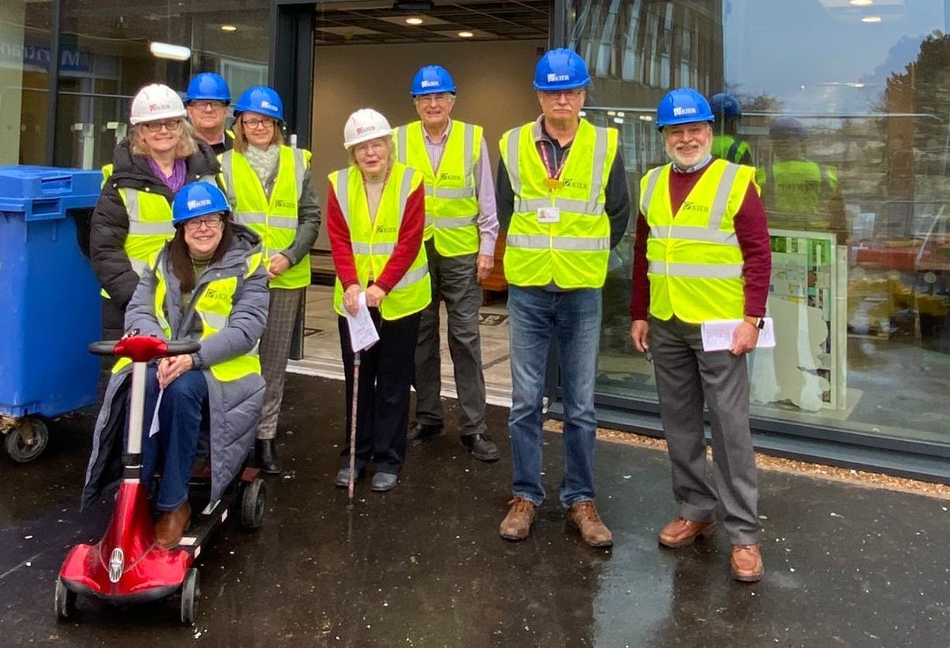
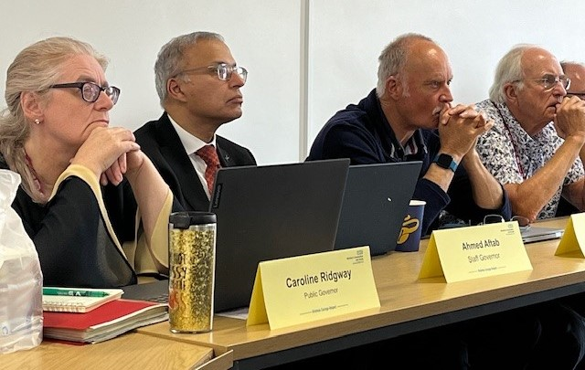
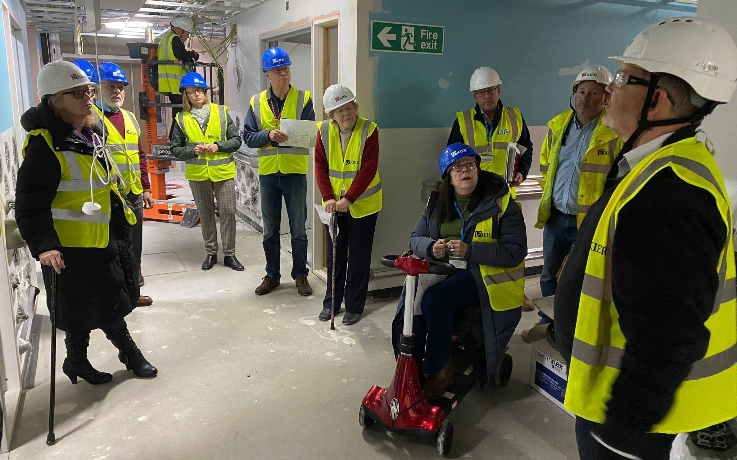
Joint NLaG Council of Governors Annual Members’ Meeting
& HUTH Annual General Meeting
CoG(25)083 – Governor Elections
YOUR LOCAL HEALTHCARE …
YOUR CHANCE TO BE INVOLVED!
22 October 2025
Working in partnership:
Hull University Teaching Hospitals NHS Trust
Northern Lincolnshire and Goole NHS Foundation Trust
United by Compassion: Driving for Excellence

Slide 39

SEATS FOR ELECTION
CONSTITUENCIES AND NUMBER OF SEATS AVAILABLE :
EAST & WEST LINDSEY - 2 seats
GOOLE & HOWDENSHIRE - 1 seat
NORTH EAST LINCOLNSHIRE - 3 seats
NORTH LINCOLNSHIRE - 1 seat
Working in partnership:
Hull University Teaching Hospitals NHS Trust
Northern Lincolnshire and Goole NHS Foundation Trust
United by Compassion: Driving for Excellence

Slide 40

TIMETABLE
Notice of Election 1st September 2025
Close of Nominations 29th September 2025
Last date for Withdrawal 2nd October 2025
Ballot starts 20th October 2025
Close of Ballot 5pm 13th November 2025
Declaration of Result 14th November 2025
Working in partnership:
Hull University Teaching Hospitals NHS Trust
Northern Lincolnshire and Goole NHS Foundation Trust
United by Compassion: Driving for Excellence

Slide 41

VOTING IS NOW OPEN for the following constituencies:
GOOLE & HOWDENSHIRE
NORTH LINCOLNSHIRE
Working in partnership:
Hull University Teaching Hospitals NHS Trust
Northern Lincolnshire and Goole NHS Foundation Trust
United by Compassion: Driving for Excellence

Slide 42
A look into how we ensure timely flow on Ward 5
Information gathering
Pre planning
Prioritise
Communication
Supporting one another

Slide 43
Board rounds…….these happen daily 3 times a day around 8.30am, 12pm and 3pm, a time to get together with doctors, nurse in charge, therapists and the care navigator to discuss the whole ward, this is a time to pick out definite discharges, potential discharges and a time to discuss anything that we could help with as a team to prepare for a discharge for example referrals (even looking ahead to tomorrow….the next day…and so on) after a board round.
How I prepare for board round…….

Slide 44
D2A Information gathering from point of admission is key to a safe discharge, communicate with patient, NOK, care homes to gather as much information as possible to ensure you have an understanding of what your patient requires and what pathway they are going to be under when MOFD (send D2A as early as possible) Welcome Home referral?
Liaising with IDT or the appropriate social team for your patient
Ensure referral are done accordingly….district nurses…bowel and bladder…..vyne etc

Slide 45
Communication is key - Liaising with other specialities for example patients for transfer to other wards and or other hospitals, liaise with your ward doctor…has your patient been accepted? What is the name of accepting doctor?
Liaising with departments - this could be for a procedure / scan etc, ensuring referrals have been received, is there a date or time yet for said procedure that is required, do we as a ward need to prep the patient in any way to ensure procedure goes ahead.
Sending referral as board round is happening? Continuous updates
Our operations centre team also support with a number of things, with the escalation of a patient, the chasing of requests, transport, and much more

Slide 46
Flow Campaign
We have started to have monthly meetings which is our ‘flow campaign’
Led by Kay Newton our head of patient flow.
This gives all wards an opportunity to view data over the month prior to look at specific information for example discharge lounge utilisation, AM discharges and re-admissions
This is also a chance for us to communicate with any ideas, concerns or general information we have about our patient flow
Right 2 Reside and knowing you are correctly updating the houses (something we do daily)

Slide 47
Added information
The safe discharge board on ward 5
This supports other staff members with adequate information to ensure they can contact the appropriate people for D2A updates, know how to make the referrals to the right areas and also that they can make sure their patient’s discharge is safe by looking at the board and knowing they have covered everything.
Collect information
Send D2A to appropriate area
Update houses
Chase outcome

Slide 48
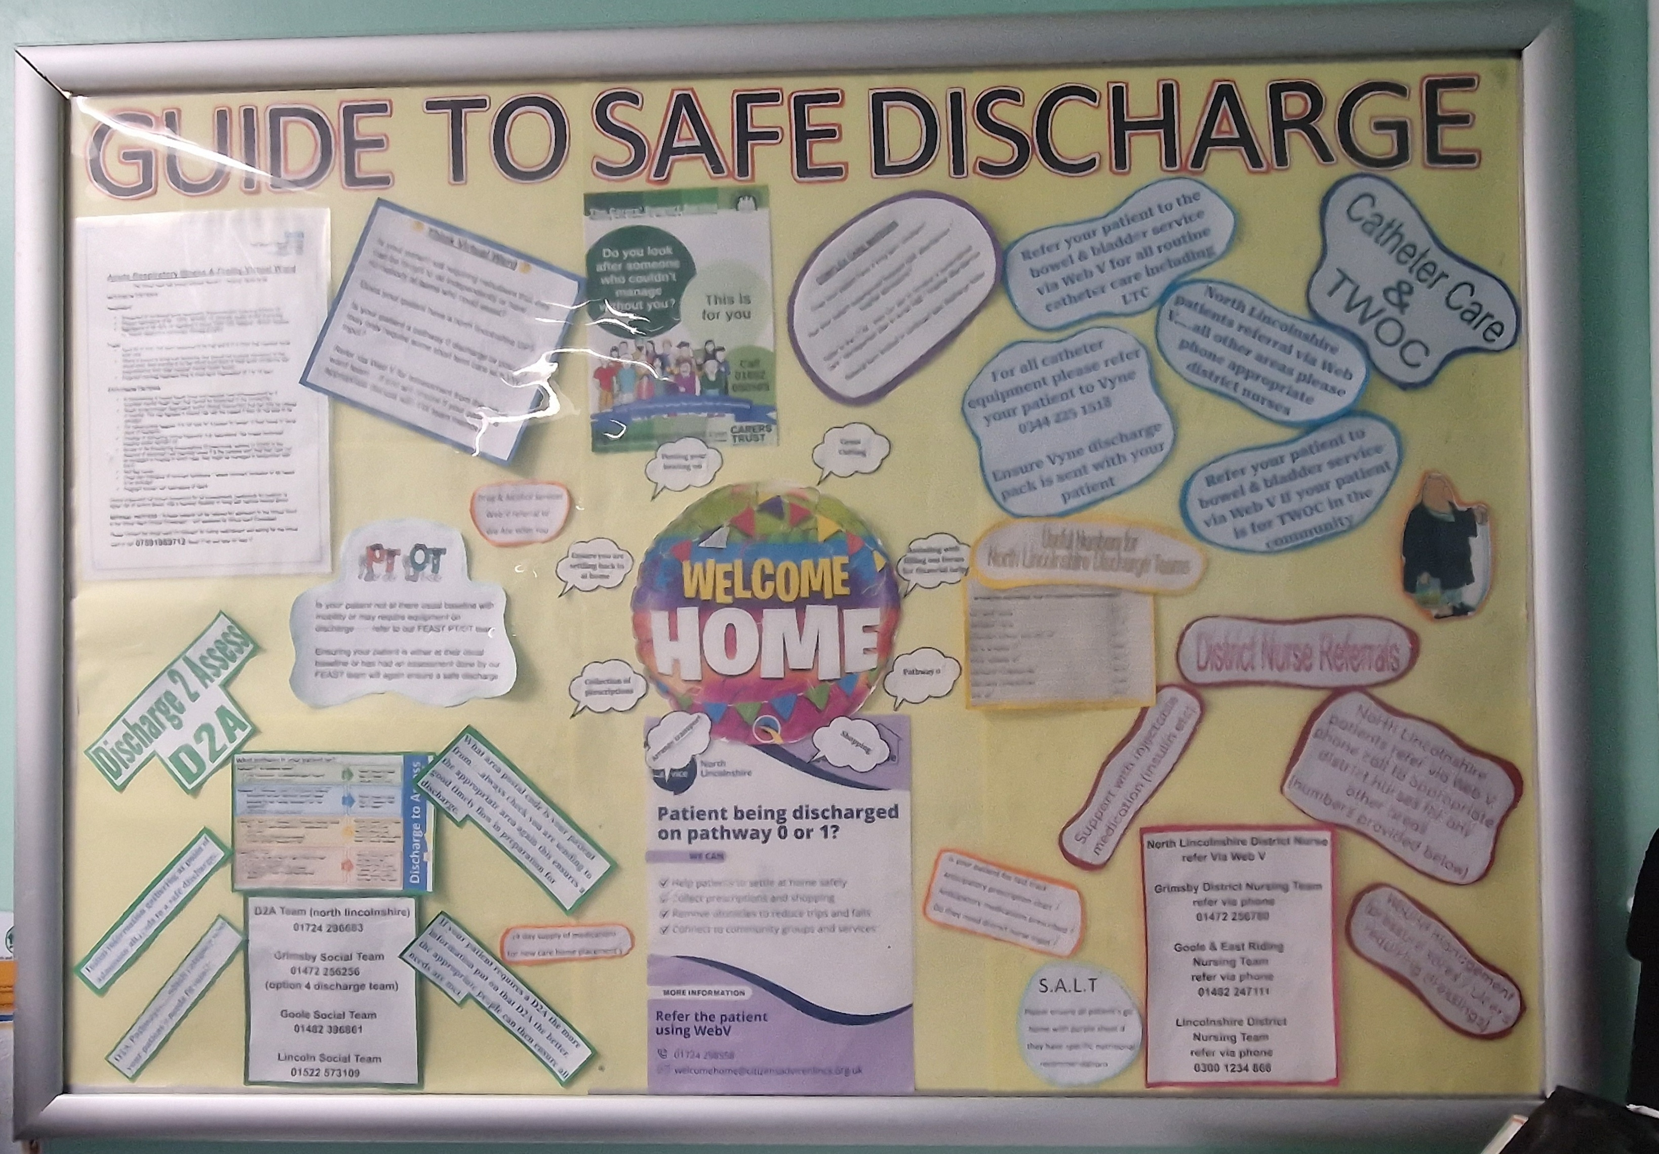

Slide 49
S Sick Patients
H Home Patient
O Other Patient
P Plan for Flow

Slide 50
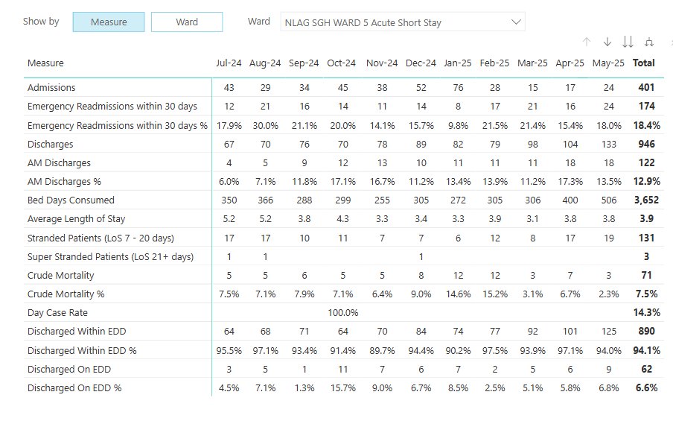

Slide 51
Base Ward | NLAG SGH WARD 5 Acute Short Stay
Patient Type | (All)
Row Labels | Sum of Admissions | Sum of Transfers In | Sum of Discharges | Sum of Transfers Out
2024
Jul | 43 | 131 | 67 | 83
Aug | 29 | 153 | 70 | 112
Sep | 34 | 162 | 76 | 120
Oct | 44 | 159 | 70 | 132
Nov | 38 | 193 | 78 | 154
Dec | 52 | 166 | 89 | 129
2024 Total | 240 | 964 | 450 | 730
2025
Jan | 76 | 114 | 82 | 111
Feb | 28 | 168 | 79 | 114
Mar | 15 | 225 | 98 | 141
Apr | 17 | 185 | 104 | 98
May | 24 | 183 | 134 | 73
Jun | 36 | 176 | 120 | 92
Jul | 39 | 178 | 147 | 70
Aug | 21 | 206 | 140 | 85
Sep | 34 | 166 | 98 | 102
Oct | 19 | 70 | 35 | 50
2025 Total | 309 | 1671 | 1037 | 936

Slide 52
Thank you for listening.

Slide 53
Neighbourhood Health
Dr Faisel Baig MBChB MRCGP PGCME
GP & Medical Director for Primary Care,
NHS England - North East and Yorkshire
National Primary Care Medical Directorate Lead for Older People,
NHS England
National GP Appraisal Lead (Acting),
NHS England
Notes:
Standard title slide

Slide 54

3 July 2025:
10 Year Health Plan for england
Hospital to Community Care
Transitioning care delivery from hospitals to neighborhood health centres and community-based services
Emphasis on integrated local care with extended hours and broader services (eg mental health, lifestyle support)
Goal: Reduce pressure on hospitals and improve access to care closer to home
Analogue to Digital Transformation
Digitally transforming the NHS with tools like AI medical scribes, expanded NHS App, and 24/7 online access
Aim: Enhance efficiency, reduce administrative burden, and improve patient experience
Focus on making digital the default while preserving patient choice
Sickness to Prevention Focus
Shifting focus from treating illness to preventing it through proactive health management
Investment in public health, lifestyle interventions and personalised care plans

Slide 55

10 Year Health Plan for England
The 10YHP set an ambition to deliver a Neighbourhood Health service designed around populations, bringing care to local communities, creating new infrastructure including neighbourhood health centres and mental health emergency centres, empowering patients through personal care plans and health budgets, shifting spending away from hospital care and replace outpatient appointments with digital advice where suitable.
And specifically committed to:
Restore GP access and introduce new GP contracts
Establish a Neighbourhood Health Centre in every community
Invest £120m for ~85 mental health emergency departments
Ensure 95% of people with complex needs are offered a personal health budget (PHB) by 2028/29 and a universal offer for all who would benefit by 2035
Reduce expenditure on hospital are over the next 10 years
Deliver more urgent care in the community

Slide 56
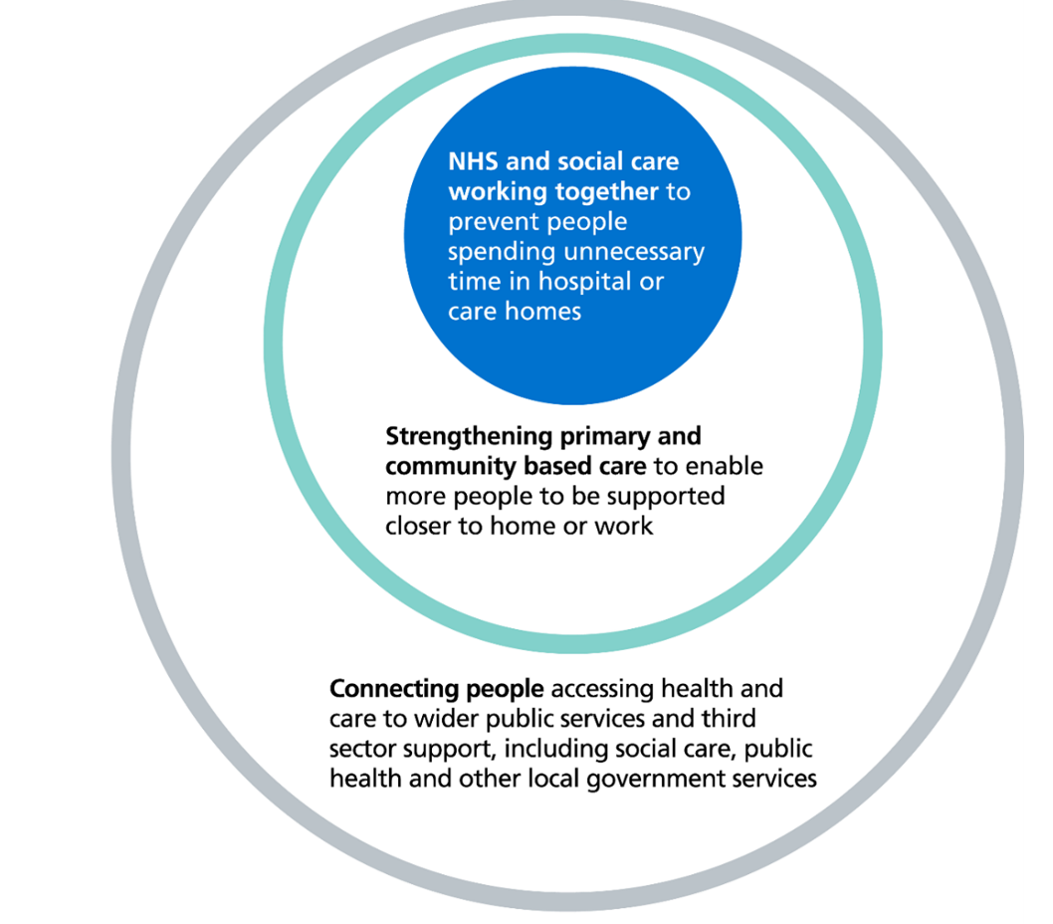
What is Neighbourhood Health? And why Neighbourhood Health?
At its heart, Neighbourhood Health is about bringing care closer to where people live, strengthening prevention, and making sure services are joined up across the NHS, local government, social care, and the voluntary sector.
A Neighbourhood Health Service will support people to stay healthier for longer and improve access to high-quality care in the community. This will mean organisations working together as a team to proactively identify, support and manage people’s health needs.
Through Neighbourhood Health, everyone will benefit from a focus on preventing ill health as well as easier access to healthcare when they need it. For people with a long-term condition this will include proactive monitoring, management and continuity of care, and for those with multiple conditions or more complex needs, this means much more coordinated and joined-up care.
Where appropriate, people will be supported and treated at home, or as close to home as possible, including access to specialist and urgent care in the community, avoiding unnecessary attendance or admission to hospital.

Slide 57
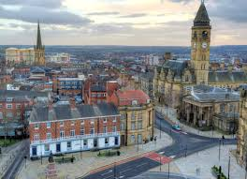
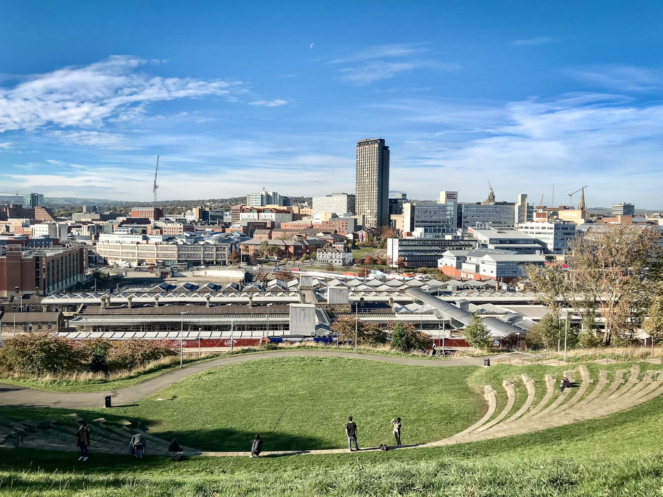


Examples from our region
Wakefield integrated neighbourhood team - Integrated neighbourhood team for adults over 70 yrs who are susceptible to acute readmission or spent 14 days consecutive admission in last 3 years. Coordinated management across wider health and social care to support improved health.
Sheffield Northeast model neighbourhood (MEN) project - 5-year multi agency & community approach to work in four deprived areas working differently to connect people to network to support social contact, tackle huge health inequalities and support people to reman healthy.
Cumbria, Northumberland, Tyne and Wear (CNTW) - Based out of Copeland Community (c 62,432 pop) 7 teams establishing a whole system, MH recovery-oriented community approach that is user focused with collaborative commissioning that includes a multiservice information-sharing agreement.
Jean Bishop Centre (Hull) - Now in its fifth year, Jean Bishop Integrated Care Centre in Hull is a leading example of NHS, social care, voluntary, fire and rescue services working collaboratively to keep thousands of frail and elderly people in the surrounding area fit, out of hospital and living independently at home or in their care setting.

Slide 58



The National Neighbourhood Health Implementation Programme (NNHIP) will adopt a test-and-learn approach to support delivery
The NNHIP is a large-scale change programme, that will gather and disseminate learning to create exemplars and embed the culture required for delivery. It will be overseen by a joint DHSC/NHSE Taskforce which reports to the Secretary of State. The Taskforce has four enabler subgroups; workforce, digital/data, funding flows and estates.
Initial focus for year one (2025/26):
Supporting progress of NbH
Coaching & building capacity
Informing strategy and policy
Working with 43 places across England during its initial phase
Building on learning from Places so far and co-producing evidence-based change components
Establishes a social movement for change and knowledge spread to other places and population cohorts.
Provide dedicated coaching support and access to subject matter expertise alongside workshops and networking to implement change components, enable peer-to-peer learning and development of collaborative improvement and system leadership skills
Build capacity and capability in places to implement the vision and service model
Informing future strategy, policy and development of NH including identifying barriers and solutions to implementation
Rigorous monitoring of outcome metrics monthly, with ongoing rapid insights capture and evaluation to test, learn and refine
Components of NNHIP
Culture of change | External expertise | National coaches | Learning workshops and environment | Leadership development Building a social movement/Robust evaluation and monitoring of outcomes
Built on learning from places who have been progressing neighbourhood working across the country and previous programmes

Slide 59

NNHIP ‘Wave 1’ places in NEY
Next steps
Workshops to finalise core outcome measures/ metrics/ benefits
National coaches appointed to work with places
Develop national framework for neighbourhood health plans, define model neighbourhoods, develop contract archetypes
Enabler groups to consider health equity and the role of education and training in neighbourhood health
Sunderland
Stockton
Leeds
Bradford
North East
Lincolnshire
Wakefield
Rotherham
Doncaster

Slide 60
NEY Regional Governance
RET / MeX (regional oversight and assurance group)
PCCS Exec Group
NHSE NBH Implementation
NHSE Frailty Collaborative
ROAG
NBH Oversight Group
NHSE National
CHS Board
SRO: Matthew Groom
NBH Oversight Group Remit:
Provide support and oversight of delivery
Identify and mobilise key partners and collaboration opportunities
Develop a governance framework that supports innovation
Support the drive, transformation and evaluation of community health services
Hospital to Community
Analogue to Digital
Treatment to Prevention
NH Lead: Tracy Wright
Clinical Leadership: Dr Faisel Baig
ICB Community Collaboratives / NBH focus

Slide 61
Next Steps
Expected nationally:
Model Neighbourhood
National framework for neighbourhood health plans
Model System Archetypes
Model Neighbourhood Health Centre Archetypes
Priority Steps locally:
Step 1
Agree neighbourhood footprints around natural communities
Ensure good access to high quality general practice
Step 2
Step 3
Continue to improve the Primary/Secondary care interface
Step 4
Agree plans with LA partners to establish Integrated Neighbourhood Teams (INT) focused on people at higher risk of hospital admission
Agree plans with LA partners, to delivery multi-neighbourhood urgent, acute and rehabilitative care
Step 5
Step 6
Start to plan how to remodel outpatients pathways

Slide 62
Neighbourhood working
“Neighbourhood health is both a mindset and method. It is not just about delivering care in new places, but designing care differently – locally informed, community-led and coordinated across systems. It centres on trust, relationships and community insight. It enables services to be co-designed with local people and tailored to each area’s social, cultural and environmental context”.
Source: NHS Confederation

Slide 63

Francine’s story:

