Slide 1
NLaG Annual Members’ Meeting and HUTH Annual General Meeting
Wednesday 14 October 2026
The event will start soon
Please ensure your microphone is muted when you are not speaking.

Slide 2


Joint AGM and Annual Members Meeting
Lyn Simpson, Group Chief Executive
NHS Humber Health Partnership

Slide 3
One year, two trusts, one shared purpose
A year of sustained demand, stabilisation and clinically led improvement
19,000
£1.7bn
1m+
1.5m
staff across both trusts
combined budget
patients seen each year
people served
Serving communities on both banks of the Humber.
Five main hospital sites plus community services.
Local, acute, tertiary and community care.
Across Hull, East Riding and Northern Lincolnshire.
Our people continued to deliver compassionate care under significant operational and financial pressure.
A clinically led improvement plan created a clearer route to safer care, better access and sustained learning.
Early signs of recovery are visible, while major challenges remain in access, finance, culture and governance.
3

Slide 4
The scale of care delivered in 2025/26
Activity increased in urgent care and outpatient services
HUTH
NLaG
116,703
182,018
198,766
135,222
A&E attendances
Hull Royal Infirmary
admissions
admissions
A&E attendances
Diana Princess of Wales
Scunthorpe General Hospital
974,987
40,768
336,018
17,930
outpatient attendances
operations
outpatient attendances
operations
4
4

Slide 5
Patients’ experience and inequalities
Health inequalities in our population
Patients who would recommend the care they received to friends and family (FFT)
92–93%
88–91%+
30.6%
~1 in 4
HUTH FFT positive
NLaG FFT positive
population in CORE20
children in poverty
Admitted waits are longer for people in more deprived communities.
People in the most deprived decile miss appointments at 6.5 times the rate of the least deprived.
Targeted screening and multidisciplinary support are beginning to remove barriers.
Inpatient and outpatient feedback remained strong.
Recurring concerns focus on waiting, delays and communication.
Digital and accessible feedback routes are being strengthened.
5
5
5

Slide 6
Clinical engagement and our Integrated Improvement Plan (IIP)
Listening to Clinicians, Learning from Patients
How clinical teams shaped the plan
What patients and communities will notice
Clinical teams shaped the plan through structured engagement sessions, sharing service experience and priorities for patient care.
The Clinical Policy Group brings clinicians across specialties and sites into decisions, alongside Chiefs of Service on the Senior Leadership Team.
The IIP builds on this clinically led plan, refreshed with NHS England support.
Safer, more reliable care
Clinical governance, safety and quality reduce avoidable harm and strengthen learning.
Timelier access and flow
Operational performance focuses on UEC, discharge, planned care, diagnostics, cancer and recovery.
Patient voice drives action
Patient experience, complaints and PALS improvement should demonstrate listening, learning and action.
Seven key workstreams
Equity and population health
Reducing the Core20 access gap supports inclusive and fair improvement.
1. Leadership
2. Clinical governance
3. Safety and Quality
4. Medical / clinical model
5. Operational Performance
6. People
7. Financial recovery
Sustainable services
Finance, productivity and workforce control protect services and support resilient care models.

Slide 7
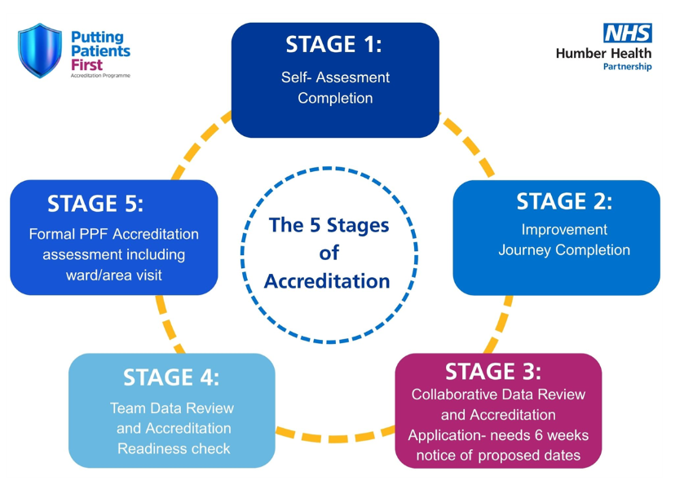
Putting Patients First: ward accreditation
Continuous improvement for the highest standards of care
Starting with 25% of wards
The programme will expand across the Group to include Theatres and Outpatients.
Five CQC Key Lines of Enquiry
Assessment combines audits and service data with patient and staff feedback, records, care observations and patient journeys.
Gold and Diamond awards
Gold: 90% overall compliance and 90% in both Safe and Well-Led. Diamond: 95% overall and 95% in both domains. Below 90%, no award. Teams remain in development.
Ward-to-board assurance
Benefits for staff
The programme identifies improvement themes, supports shared learning and frontline leadership, and recognises excellent care.
Develops professional skills, supports a more efficient and supportive workplace, and recognises and celebrates excellent care.
Notes:
Putting Patients First Accreditation Programme
Source: programme information supplied directly by the user, 8 October 2026.
Purpose: Humber Health Partnership’s programme supports patient safety and quality standards through continuous improvement and the highest standards of care.
Staff benefits: active involvement develops new skills and professional growth. Continuous improvement supports a more efficient and supportive work environment. The programme recognises and celebrates staff dedication and examples of excellent care.
Rollout starts with 25% of wards across the Group and will include other departments, including Theatres and Outpatients.
Assessment uses quality standards across the CQC’s five Key Lines of Enquiry. Evidence includes audits, incidents, complaints, workforce data and learning reviews; patient engagement; staff engagement, knowledge and understanding; manager and service lead engagement; digital and written patient records; care-environment observations; and patient journey, flow and discharge reviews.
Gold requires 90% overall compliance, including 90% in each of Safe and Well-Led. Diamond requires 95% overall, including 95% in each of Safe and Well-Led. Below the minimum 90%, no accreditation is awarded and the team remains in development. Teams revisit improvement areas and complete a new accreditation application when appropriate, with submission agreed by the care group senior team.
The programme provides ward-to-board assurance, demonstrates compliance, identifies improvement themes, supports shared priorities and learning at ward, department and Group level, and promotes frontline leadership and continuous improvement.
Existing five-stage diagram retained from the user’s presentation. Supporting document named in supplied text: Putting Patients First - Ward and Clinical Area Accreditation Standard Operating Procedure (PPF Visual SOP 2026 Correct .jpg).

Slide 8
Quality and safety: improvement is happening
Recent inspections and safety data provide green shoots
GOOD
GOOD
IMPROVED
Goole outpatients
Hospital end-of-life care at Grimsby and Scunthorpe improved by two ratings, from Inadequate to Good, in May 2026.
North Lincolnshire community end-of-life care also rated as good
HRI urgent & emergency care
Rated Good across all five domains and Good overall in February 2026.
Moved from Inadequate to Requires Improvement following the September 2025 inspection.
SECTION 31 NOTICE REMOVED
8 → 4
Hull Women and Children’s Hospital
Never Events at HUTH
Removed after improvements to staffing, patient safety and mandatory training.
A 50% reduction from 2024/25 to 2025/26, with strengthened learning and safer surgical processes.
8

Slide 9
Performance: improvement is happening
18-week referral to treatment time
12-hr Emergency Dept breaches
Cancer 28-day faster diagnosis
Both trusts’ performance against the 18-week referral-to-treatment standard was at or above plan in September.
HUTH better than plan, with performance on very long waits now ranked 45th best out of 134 hospital trusts nationally.
In August HUTH was ranked 4th most improved in the country compared with last year with performance improving from 53% to 73%
Further improvement required
Green shoots but more work required to move both trusts out of National Oversight Framework level 4 into level 3
9

Slide 10
Our people: improvement is happening
Behind every improvement our colleagues are finding better ways to care for patients
Dementia-friendly ward improvements at Scunthorpe.
New MRI technology helping to reduce patient anxiety and improve access.
27% fewer delayed ambulance handovers at Hull
Goole ranked fourth nationally and first regionally among elective hubs
Scunthorpe wards 22 and 23 reduced falls and pressure ulcers
More than 500 people with previously undiagnosed COPD identified through Castle Hill’s FRONTIER programme.
75 patients fitted with hearing aids in one day by Scunthorpe’s audiology team through group fitting sessions.
10

Slide 11
Our people
Improvement depends on colleagues feeling safe, supported, listened to and able to lead change
2025 staff survey: improvement at both trusts
HUTH: 4 of 9 themes improved
NLaG: 7 of 9 themes improved
We are building on this success in four specific areas:
.
Safety culture reset
Ward accreditation, safety-focused QI and recognition
Civility and respect
Compassionate leadership and targeted team interventions
Staff voice
Stronger speaking-up routes, huddles and staff-led improvement
Equity and inclusion
Action on discrimination, opportunity and reasonable adjustments
11
Notes:
[Sources]
20260312 staff survey (12 March 2026), entity key file_a33489c3, paragraphs 1–3. Retrieved from enterprise files.
2025 versus 2024: HUTH improved in four of nine key themes and NLaG in seven. HUTH staff engagement was the only theme reported as deteriorating. Further work is required against some measures to reach and exceed national averages.
[/Sources]

Slide 12
Financial sustainability and responsible stewardship
2025/26 year-end position: multi-year recovery remains essential
£36.5m
£94.8m
£144.2m
Group year-end deficit
Group savings delivered
Group capital spend
HUTH: £22.0m deficit
NLaG: £14.5m deficit
£130m target
£35.2m savings shortfall
In line with plan across the Group.
Group agency and bank spend: £66.9m, down £0.4m from 2024/25.
Elective Recovery Fund: £5.1m below baselines, with no additional income or penalties applied by the ICB.
The response
Return to a sustainable break-even position through a multi-year recovery plan.
Align workforce, demand, finance and capital planning at specialty and trust level.
Protect patient safety and clinical priorities while improving productivity and reducing duplication.
Use capital and sustainability investment to improve resilience and reduce long-term cost.
12
Notes:
[Sources]
HUTH Annual Report 2526 Draft V5 .docx, Finance section: Group deficit £36.5m, HUTH £22m; savings £94.8m versus £130m target; capital spend £144.2m in line with plan; ERF £5.1m below baselines with no additional income or penalties applied by ICB; agency and bank spend £66.9m, £0.4m lower than 2024/25. User attachment file_ba08a367.
NLAG Annual Report 2526 Draft V5.docx, Finance section: NLaG deficit £14.5m. User attachment file_e25a1dc5.
Calculation: £22.0m + £14.5m = £36.5m. Savings shortfall: £130.0m - £94.8m = £35.2m.
Source discrepancy: NLaG narrative describes a £35.5m Group deficit target (implying £1.0m adverse variance), while its embedded finance table reports the £36.5m deficit as £36.5m adverse to a break-even plan. No definitive plan variance is stated on the slide. The embedded table also reports £19.9m year-to-date support for Group financial position. Draft basis retained visibly.
[/Sources]

Slide 13

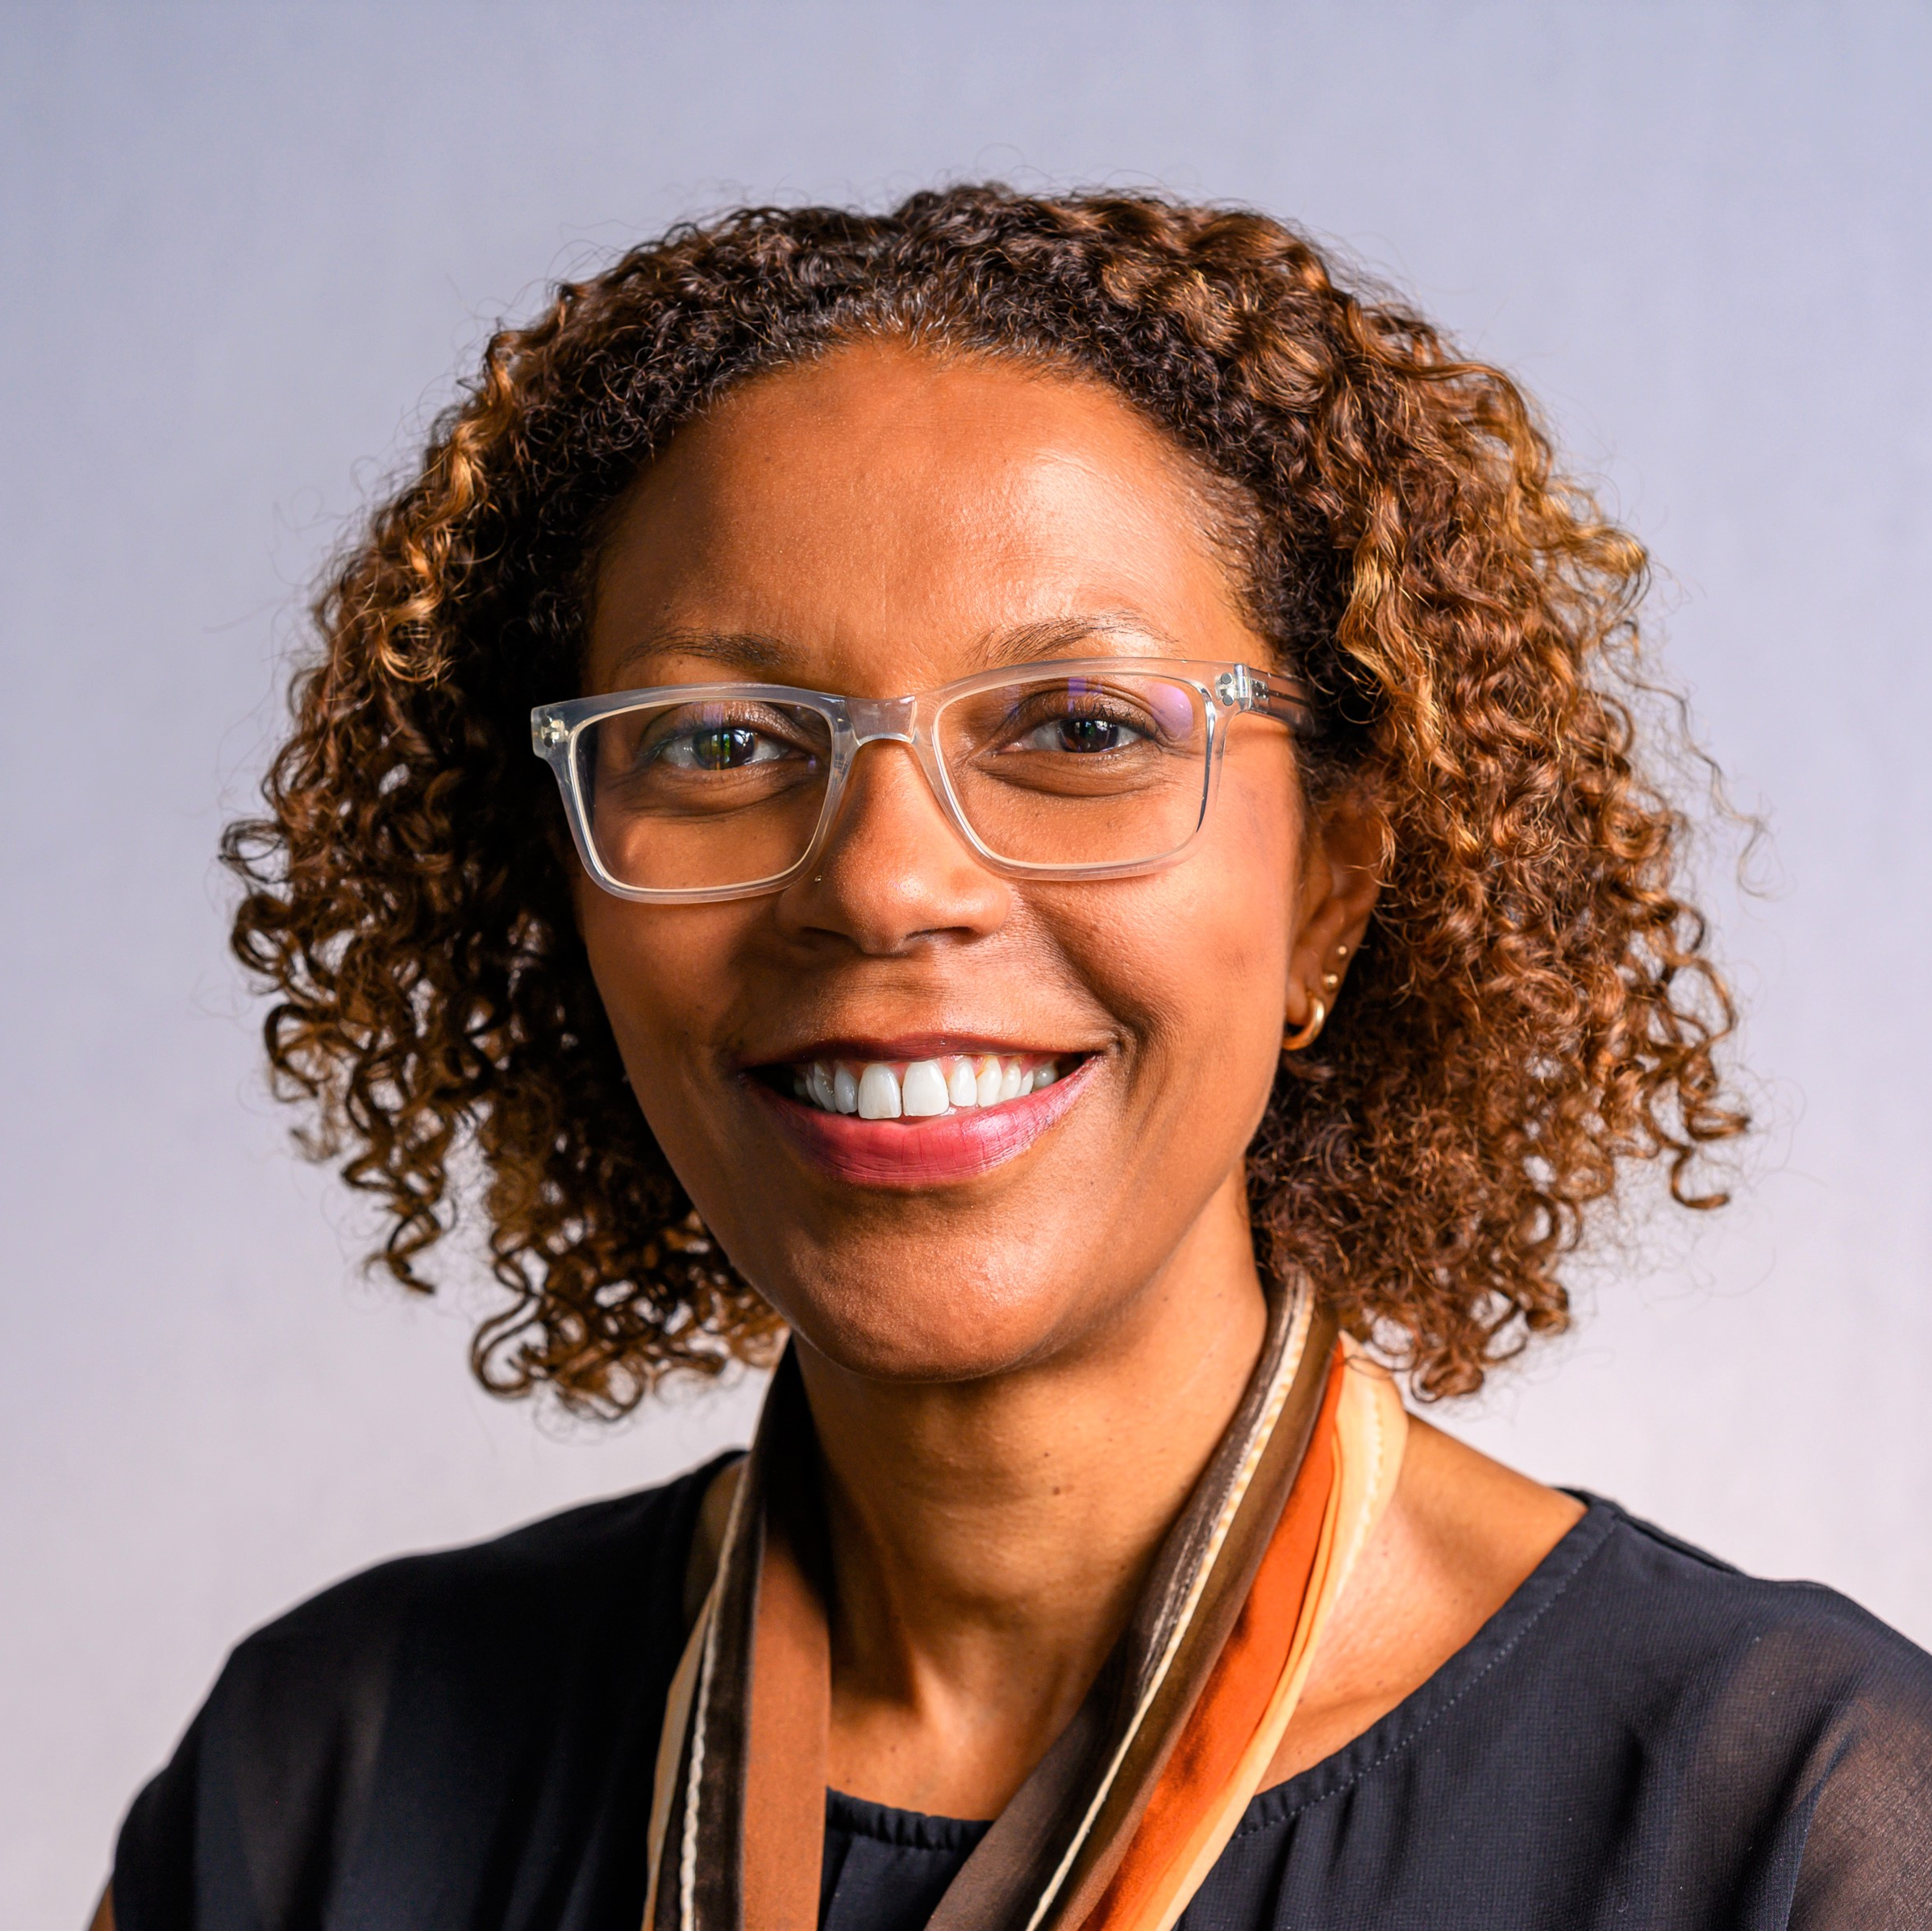
The future: two organisations, continuing collaboration
Boards agreed on 10 September 2026 that disestablishing HHP was in patients’ best interests
Hull University Teaching Hospitals NHS Trust
Northern Lincolnshire and Goole NHS FT
Murray Macdonald
Interim Chair
From 1 October
Therese Patten
Interim Chief Executive
From 6 October
Alan Downey and Lyn Simpson continue as Chair and Chief Executive of the Group and HUTH.
Transition delivery and engagement
Seven transition workstreams
Programme Delivery Group: workstreams report to the PDG, which reports to the Transition Steering Group.
Carnall Farrar continues interim PMO support for planning, mobilisation and delivery.
Engagement includes staff, trade unions, NHS England, the ICB, local authorities, MPs and healthcare partners.
Strategy
People and leadership
Operating models and ICB commissioning
Governance, Board and legal
Communications and engagement
Quality, safety and clinical continuity
Finance and resources
Distinct boards and local accountability, with collaboration where it improves care
Clinical networks, shared pathways, system partnerships, learning and innovation
Notes:
Sources and supporting detail, 8 October 2026
NLaG appointments: Lyn Simpson staff announcement, 30 September 2026, “Murray Macdonald and Therese Patten appointed to interim leadership roles at NLaG” (email_b5db3b5f). NHS England and the Council of Governors approved the appointments. Murray starts 1 October and Therese 6 October. Existing management arrangements remain until advised otherwise. No exact separation date has been confirmed.
Governance and workstreams: Lyn Simpson, “HHP: Transition Workstream Leadership”, 24 September 2026, in email_e4c2dcf5. Each workstream reports to the Programme Delivery Group, which reports to the Transition Steering Group. Carnall Farrar provides interim PMO support while a permanent function is established. Workstream owners: Strategy – Group Chief Policy Officer. People and leadership – Group Chief People Officer. Operating models and ICB commissioning – Group Chief Delivery Officer. Governance, Board and legal – Group Board Secretary. Communications and engagement – Director of Communications. Quality, safety and clinical continuity – Deputy Chief Nurse and Deputy Chief Medical Officer. Finance and resources – Group Chief Finance Officer.
PDG operation: Jacqueline Roberts, “Transition Programme Delivery Group - 1/10 minutes and actions”, 5 October 2026 (email_771f9a6e) confirms the 1 October meeting. “HHP Transition - Communications and Engagement Workstream Meetings”, 5–6 October 2026 (email_11859195) confirms ongoing Carnall Farrar support and workstream reporting.
Stakeholder engagement: source presentation slides 18, 20 and 22, and “23.9.26 CHH Staff Roadshow article FINAL” (file_6092ec95). Staff roadshows, briefings and trade union involvement support engagement. The ICB, NHS England, local authorities, MPs and healthcare partners are key stakeholders. No claim is made here that all stakeholder groups attend the operational PDG.
Retained original intent: each trust will have its own board, chief executive and executive team, with leadership closer to local services and communities. Collaboration continues where it improves care.
Portraits: user-supplied Murray McDonald 01 square small.jpg and Therese Patten, Chief Executive - board pic.jpg. Images retain their original proportions using a centred square crop.

Slide 14
Three key programmes for the next 12 months
1
Transition to HUTH and NLaG
Business continuity is paramount
Stakeholder engagement essential
2
Integrated Improvement Plan
Demonstrating progress across the seven workstreams towards exit from National Oversight Framework 4
3
Financial recovery
Providing a clear account of the financial position and the role of staff in recovery.
Notes:
Three key programmes of activity for the next 12 months. Content supplied by the user on 8 October 2026.
Transition to HUTH and NLaG: explaining what is changing, why, and where collaboration will continue.
Integrated Improvement Plan: demonstrating progress across the seven workstreams towards exit from NOF 4.
Financial recovery: providing a clear account of the financial position and the role of staff in recovery.

Slide 15
Thank you
Any questions?

Slide 16

Hull University Teaching Hospitals NHS Trust – Financial Performance Review 2025/26
Emma Sayner
Group Chief Financial Officer

Slide 17
Independent auditor's report to the Directors of Hull University Teaching Hospitals NHS Trust
“In our opinion, the financial statements:
… give a true and fair view of the financial position of the Trust as at 31 March 2026 and of its income and expenditure for the year then ended;
…have been properly prepared in accordance with the Department of Health and Social Care Group Accounting Manual 2025/26; and
…have been properly prepared in accordance with the requirements of the National Health Service Act 2006. “.

Slide 18
The Trust achieved its revised control total in 2025/26, which was to deliver an adjusted position of £22m deficit.
 | £’000s
Deficit as per accounts | (1,608)
Remove impairments | (5,572)
Remove grants and donation impact | (12,876)
Sub Total | (20,056)
Remove PFI revenue costs on an IFRS basis | 12,374
Add back PFI revenue costs on a UK GAAP basis | (14,334)
Adjusted Financial Position surplus / (deficit) | (22,016)

Slide 19
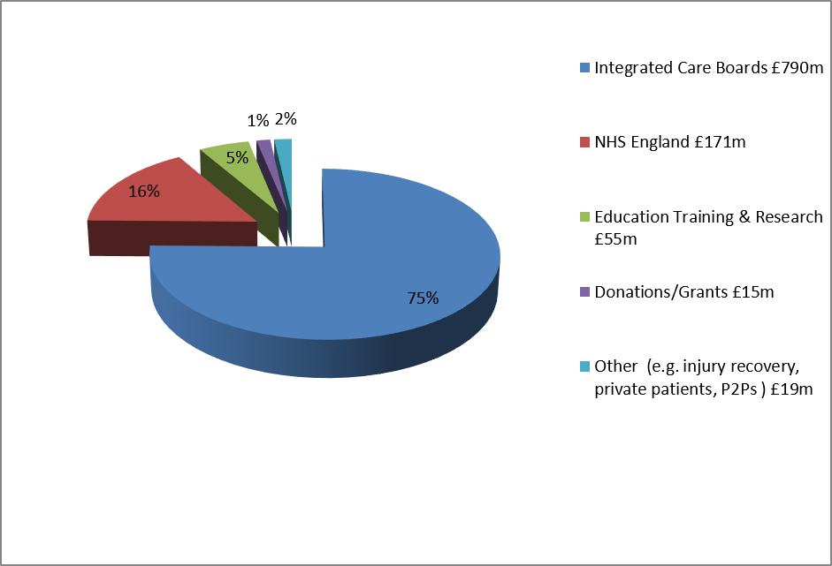
WHERE OUR MONEY CAME FROM
Our operating income in 2025/26 was just over a billion, at £1,050m, as shown below:

Slide 20
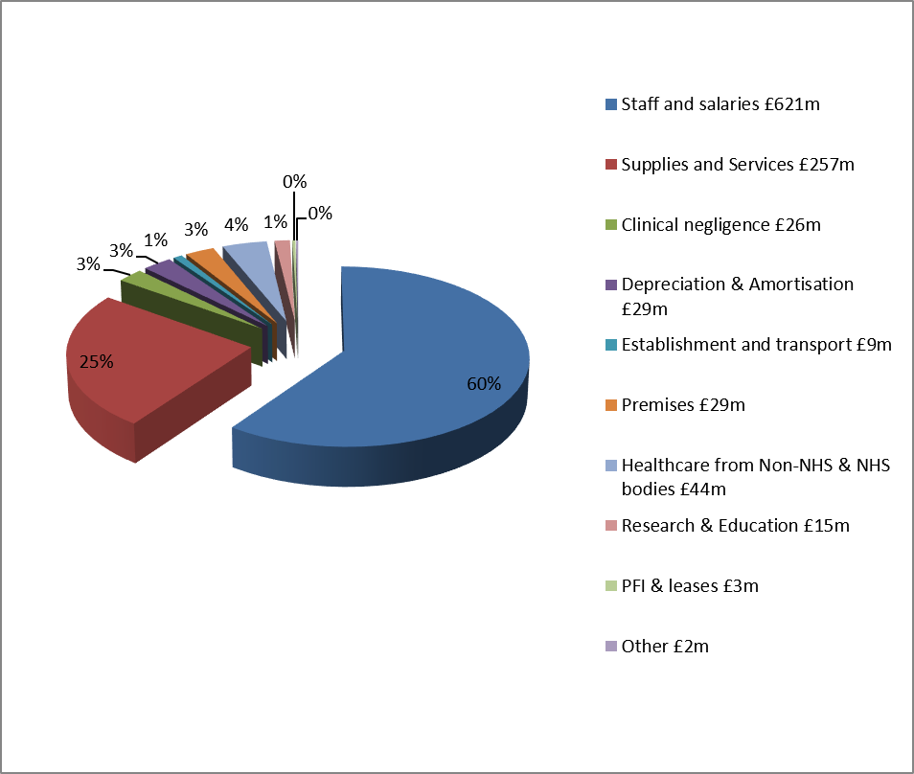
HOW WE SPENT OUR MONEY
Our operating expenditure in 2025/26 was £1,035m, as shown below:

Slide 21
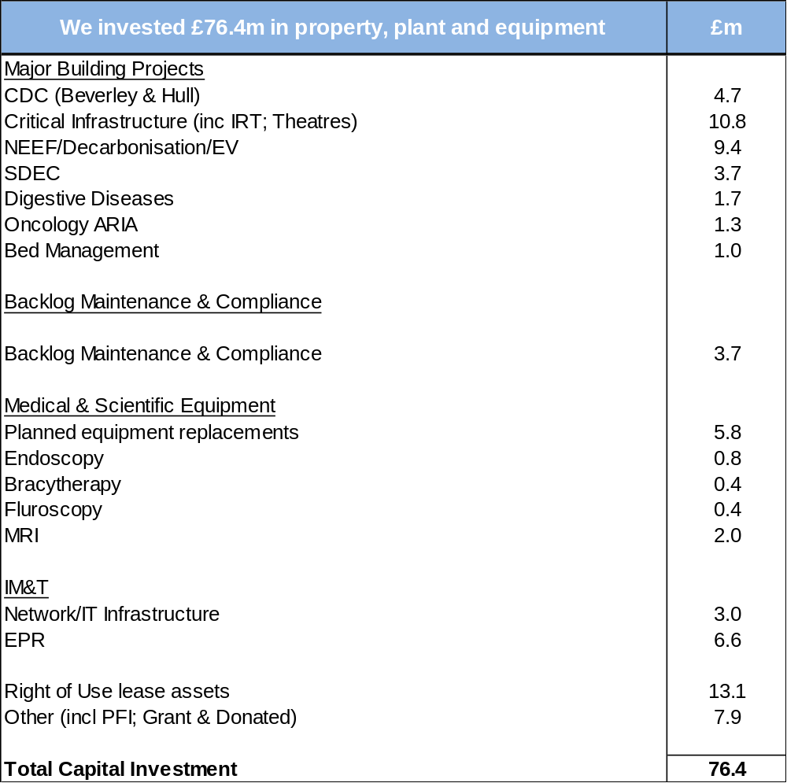
INVESTMENT IN INFRASTRUCTURE

Slide 22
BALANCE SHEET STRENGTH
In overall terms the main changes on the Trust’s Balance Sheet reflect the following:
  Non Current Assets increased by £63m – mainly the impact of extensive capital programme and the inclusion of Right of Use assets under the IFRS16 lease guidance – which included the right of use lease for the Community Diagnostics Centre (CDC) in Hull at £15m.
  Cash and cash equivalents have decreased from £34.9m to £33.1m mainly due to payables reducing and the deficit position.
  Borrowings have decreased from £84.7m to £80.4m which reflects the in-year payments on capital loans and PFI unitary payments.
  Performance against the Public Sector Payment Policy remained high, although has reduced from 2024/25 levels, to almost 77.6% by volume for our Non-NHS Suppliers and at 72.1% for NHS Suppliers due to the impact of cash management.

Slide 23
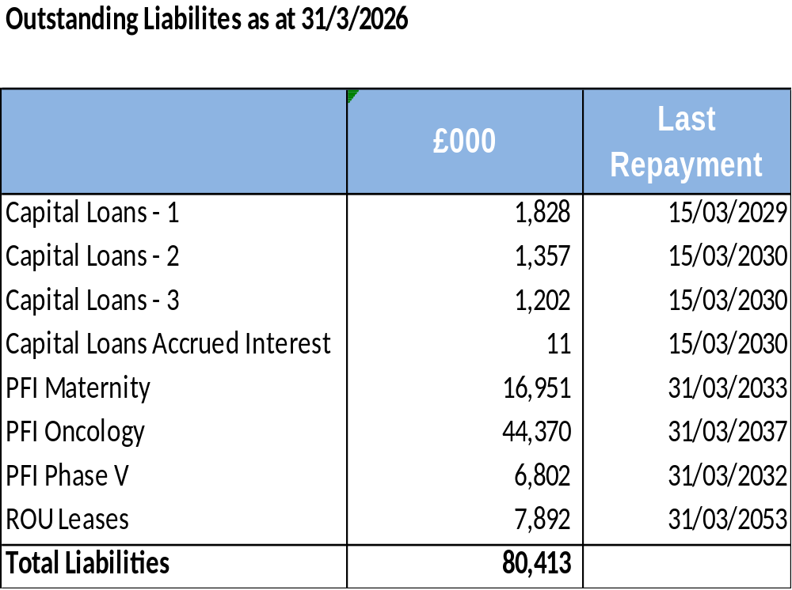
BORROWING POSITION 2025-26

Slide 24
2026/27….
Whilst the Trust has agreed a deficit plan of £39.4m for 2026/27, this is still subject to final agreement with NHS England and consequently means there is no agreed deficit funding this year to help us manage the cash flow position.
In order to deliver this deficit plan, the Trust needs to deliver a significant level of efficiency savings - with £72.9m Cost Improvements required in 2026/27. It also means that the Trust needs to apply for cash support each month.
The Trust’s forecast for capital expenditure this year is £47m (as at Oct 2026), dominated largely by major capital schemes related to national funding for completing the expansion of SDEC and discharge facilities to address constitutional standards, funding for energy efficiency schemes and Estates Safety Funding for major critical infrastructure replacement and the HRI tower block cladding scheme. Investment in IM&T projects is significant this year due to the implementation of the new Electronic Patient Record. Other schemes relate to the backlog maintenance/replacement IT and equipment replacement programmes

Slide 25
Looking ahead: underlying financial position
The Trust exited 2025/26 with an underlying recurrent deficit assessed at circa £79m.
The main drivers of the significant underlying position are:
    Deficit Support funding – (£10.7m)
    Non recurrent savings delivery – (£23.7m)
    Non recurrent funding support – (£31.6m)
    FYE of 2025/26 savings delivery - £8.6m
    NR Flexibility – (9.6m)
    Vacancy Factor review £10m

Slide 26
Northern Lincolnshire and Goole NHS Foundation Trust – Financial Performance Review 2025/26
Emma Sayner
Group Chief Financial Officer

Slide 27
Independent Auditor's report to the Council of Governors of Northern Lincolnshire and Goole NHS Foundation Trust
“In our opinion, the financial statements:
…give a true and fair view of the financial position of Northern Lincolnshire and Goole NHS Foundation Trust as at 31 March 2026 and of its expenditure and income for the year then ended;
…have been properly prepared in accordance with the Department of Health and Social Care Group Accounting Manual 2025-26; and
…have been prepared in accordance with the National Health Service Act 2006.”

Slide 28
The Trust did achieve its revised control total in 2025/26:
 | £’000s
Deficit as per accounts | (29,101)
Remove impairments | 33,183
Remove grants and donation impact | (18,587)
Adjusted Financial Position surplus / (deficit) | (14,505)

Slide 29
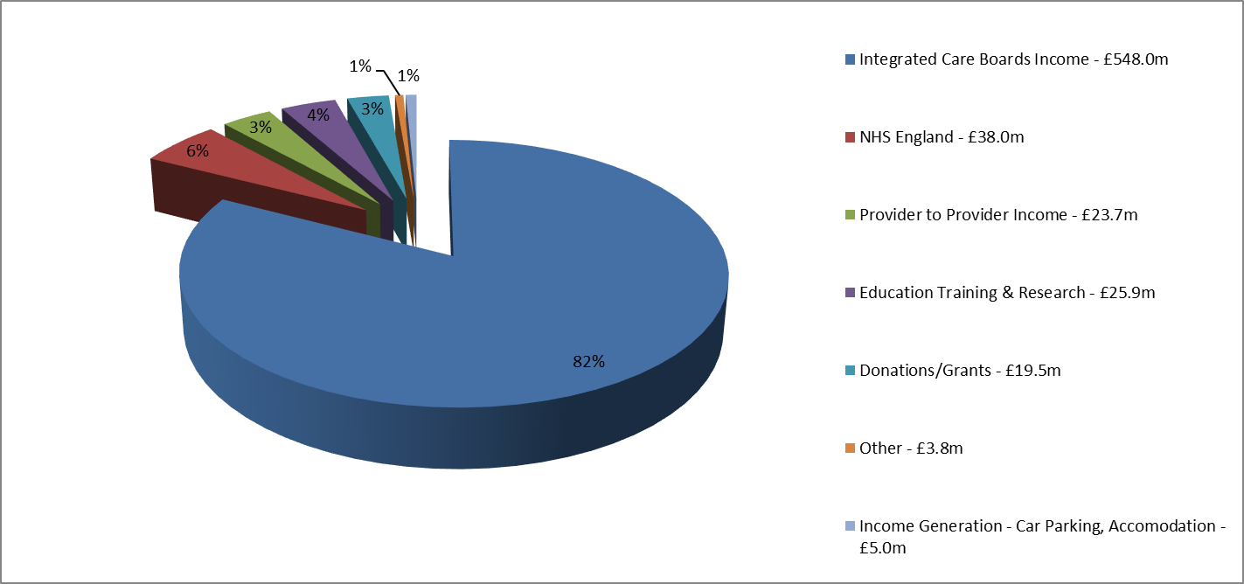
WHERE OUR MONEY CAME FROM
Our operating income in 2025/26 was £664m, as shown below:

Slide 30
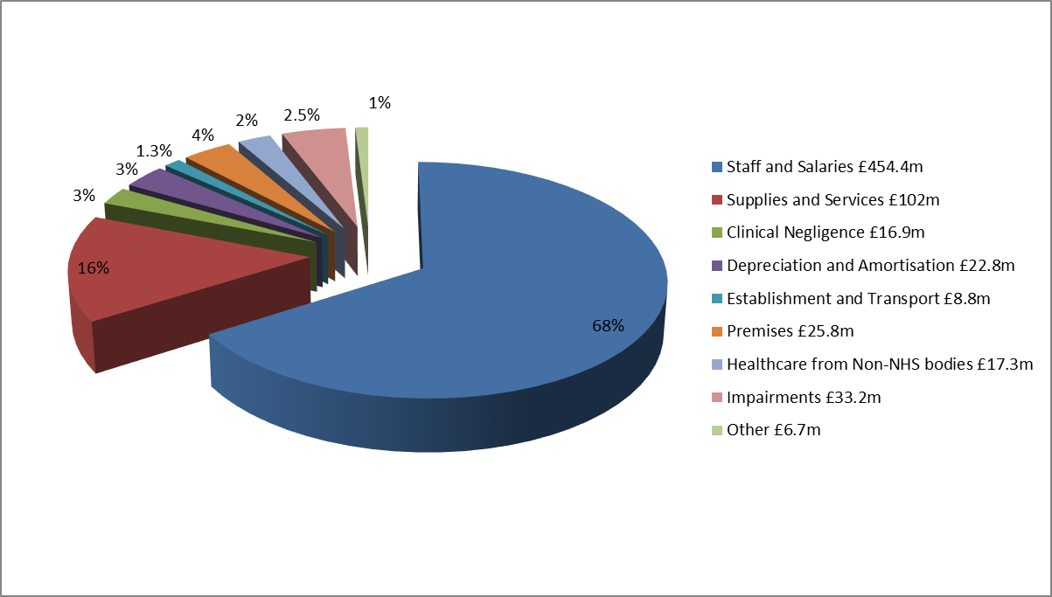
HOW WE SPENT OUR MONEY
Our operating expenditure in 2025/26 was £688m, as shown below:

Slide 31
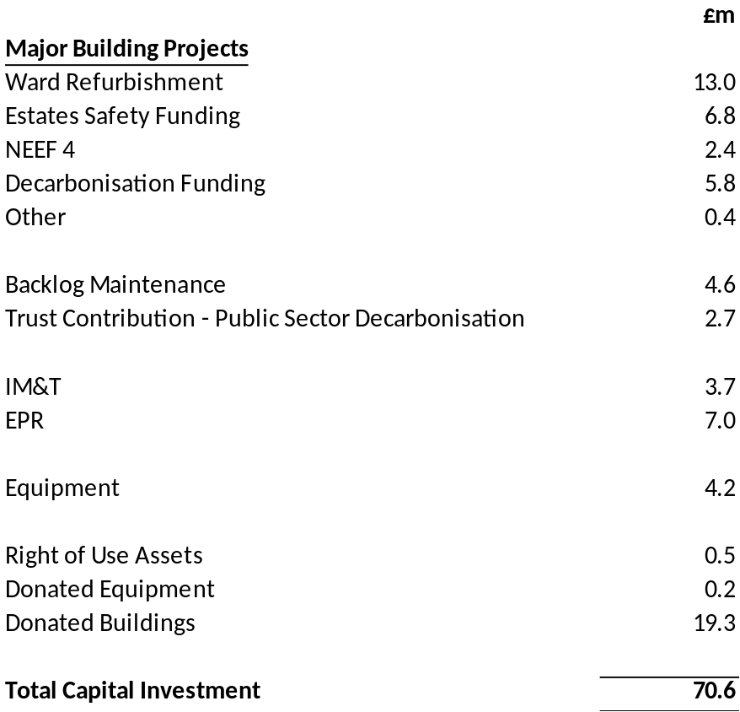
INVESTMENT IN INFRASTRUCTURE
We invested £70.6m in property, plant and equipment

Slide 32
BALANCE SHEET STRENGTH
In overall terms the main changes on the Trust’s Balance Sheet reflect the following:
  Non Current Assets increased by £12.2m – as a result of the capital spend in year, less depreciation and impairments.
  Cash and cash equivalents have increased to £40.0m reflecting the increase in capital creditors at the year end and the increase in deficit.
  Borrowings – loans have reduced from £5.6m to £4.2m, which reflects the in-year payments on capital loans. Lease liabilities have reduced to £9.0m as a result of payments in year and remeasurements.
  Performance against the Public Sector Payment Policy deteriorated in year, due to the increase in deficit and therefore reduction in cash. The value of invoices paid for our Non NHS Suppliers was 89.1% and 74.7% for NHS Suppliers.

Slide 33
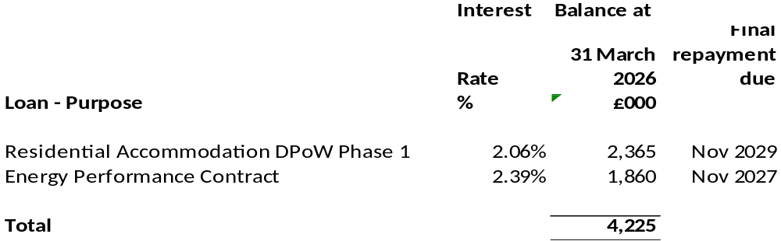
BORROWING POSITION 2025-26
Capital loans outstanding at March 26 were £4.2m.
The details are below:

Slide 34
2026/27….
Whilst the Trust has agreed a deficit plan of £23.7m for 2026/27 this is still subject to final agreement by NHS England and consequently means there is no agreed deficit support funding to help with cash management.
In order to deliver this deficit plan, the Trust needs to deliver a significant level of efficiency savings - with £61.7m Cost Improvements required in 2026/27. It also means that the Trust needs to apply for cash support each month.
The Trust’s forecast for gross capital expenditure this year is £32.2m (as at Oct 2026), dominated largely by capital schemes related to national Estates Safety funding for critical infrastructure, including theatres refurbishment, funding for energy efficiency schemes. In addition, the HASR critical care development at DPoW is planned for completion this year. Investment in IM&T projects is significant this year due to the implementation of the new Electronic Patient Record. Other schemes relate to the backlog maintenance/replacement IT and equipment replacement programmes

Slide 35
Looking ahead: underlying financial position
The Trust exited 2025/26 with an underlying recurrent deficit assessed at circa £56.3m.
The main drivers of the underlying position are:
    Deficit Support funding – (£11.1m)
    Non recurrent savings delivery – (£24.0m)
    Non recurrent funding support – (£4.6m)
    FYE of 2025/26 savings delivery £2.7m
    Non-recurrent balance sheet gains (£5.8m)

Slide 36
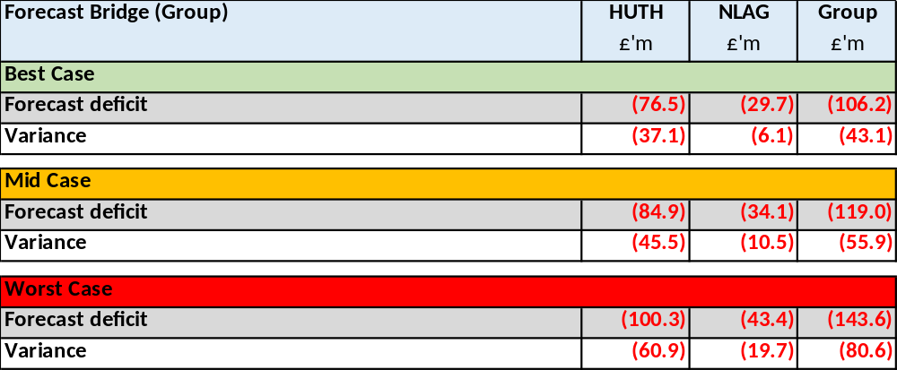
HHP Group: Key Financial Risks
Delivery of the Group’s financial plan is considered extremely high risk.
The magnitude of the efficiency plan at £119m (6.8%) for the Group is clearly the most challenging aspect within this. Development of the efficiency programme is being managed through the Financial Recovery Programme Board.
As at Month 6, the Group is reporting best, mid and worst-case forecast deficit scenarios as follows, compared with the planned deficit of £63m.
The cash management associated with the financial plan is a significant risk given the reliance on the efficiency plan for reducing costs and will need tight management of our working capital – applications are required currently for cash support most months.
Delivery of such an ambitious efficiency programme requires a complete change in mindset from all of our teams as well as from our system partners. This change in culture and the need to embrace transformation is key to successfully delivering our financial plans.
Finally, the process for devolving the partnership is underway and there is a risk that the revised structures may lead to additional costs.

Slide 37
Neighbourhood Health Provision
in Northern Lincolnshire
Including the North East Lincolnshire Trailblazer overview
Joint NLaG Council of Governors AMM & HUTH AGM
14 October 2026

Slide 38

What is Neighbourhood Health?
Neighbourhood Health (NH) organises joined-up support and care around local people,
from prevention to intensive support for those with the greatest needs.
Our ambition
How we deliver
What enables it
Improve outcomes
Reduce inequalities
Reduce avoidable demand
Shift care closer to home
Prevention and early action
Integrated access
Proactive care
Pathway transformation
Neighbourhood partnerships
Integrated teams
Population insight
Estates, digital and workforce
Healthy Neighbourhoods provides the community-led foundation for wellbeing and prevention
within the wider Neighbourhood Health approach.

Slide 39
Neighbourhood Health: current provision and development
Local delivery today, with further development in both places
North Lincolnshire
North East Lincolnshire
Current approach
In place now within the Health & Care Partnership:
✓
Community First
✓
Integrated Neighbourhood Teams
✓
Five neighbourhood partnerships
✓
National Neighbourhood Health Implementation Programme
✓
Frailty and priority cohorts
✓
Proactive frailty
✓
Home First and integrated urgent care
✓
Co-produced Community Plans
Ongoing development
In development
Co-produced neighbourhood plans
Neighbourhood Health Centres
Trailblazer and outpatient transformation
Shared principles: start with need, organise around people, work across boundaries and measure the impact.

Slide 40
North Lincolnshire: provision and ongoing development
Stronger
System Grip
Focused System Leadership
Clear Oversight
One System View
Integrated commissioning on high-impact delivery priorities
Joint Committee grip on risk, finance and delivery
Aligned Section 75 arrangements supporting joint planning and delivery
Key Decisions
Enabling Shift
Joint Commissioning
Integrated Urgent Care
Community Impact
Geographically aligned Care at Home Framework and Carers Support
Integrated urgent care supporting discharge and flow
Reduced residential admissions and strong discharge and flow
So What?
Supporting independence through neighbourhood-based care
Community First, Integrated Neighbourhood Teams, Family First, One Place Approach
Existing provision: Community First
“Neighbourhood health is not new in North Lincolnshire. Community First is the long-term integrated approach, bringing partners and communities together to improve wellbeing, support independence and reduce inequalities.”
Ongoing development and alignment
In place: 5 Health and Wellbeing Partnerships
• Integrated Assets Strategy and Neighbourhood Health Plans
• Pride in Place and Communities transformation
• Housing and worklessness alignment
• Children’s transformation and SEND reform
• Health inequalities investment programmes
• Bringing together partners around local neighbourhoods
• Shared neighbourhood insight
• Joint problem-solving across organisations
• Co-producing plans with residents, VCSE and communities
• Prevention and early intervention
Notes:
[Sources]
- North Lincolnshire Neighbourhood Health model deck
- HNY Neighbourhood Health stocktake deck, slide 35
[/Sources]

Slide 41






NEL Neighbourhood Health
01
02
03
Neighbourhood Health Plan
INTs & NNHIP
Neighbourhood Health Centres (NHC)
Framework for priorities, delivery and outcomes
Learning from implementation and INT development
Progress on NHCs
04
05
Trailblazer programme
Health & Wellbeing Board BCF support programmes
Social finance investment business case
Targeted HWB support and Communities of Practice
Create a clear line from strategy and learning to practical delivery, investment and shared improvement.

Slide 42
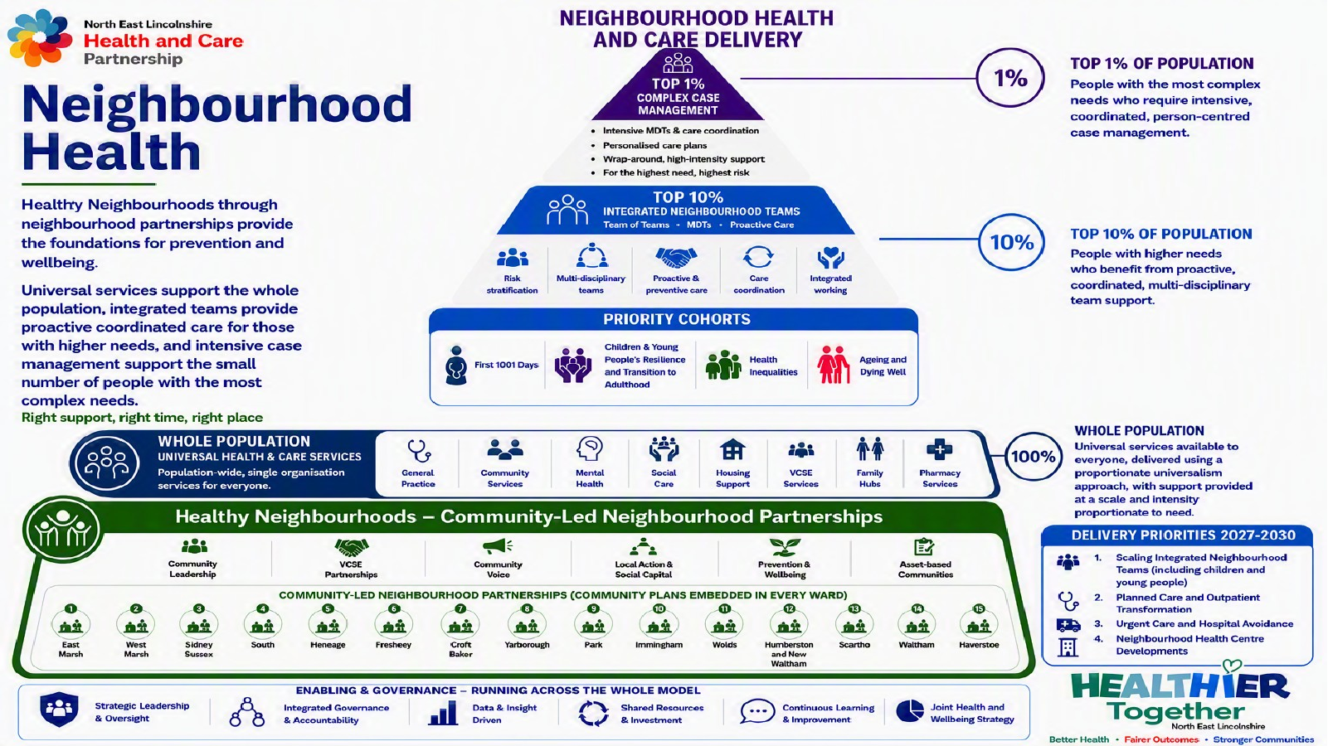

Slide 43




North East Lincolnshire: provision and development
Existing neighbourhood delivery provides the foundation for further development
In place now
In development
01
02
03
04
Integrated delivery
Proactive care
Place infrastructure
Transformation opportunity
Meridian multidisciplinary huddles, multi-agency working and VCSE participation
Proactive frailty and existing integrated neighbourhood teams as delivery foundations
Neighbourhood Health Plan, Weelsby View and wider Neighbourhood Health Centre development
Community urgent care, planned care and outpatient transformation linked to neighbourhood delivery
The proposed Trailblazer builds the evidence, operating model and investment case
needed to scale proactive care.

Slide 44
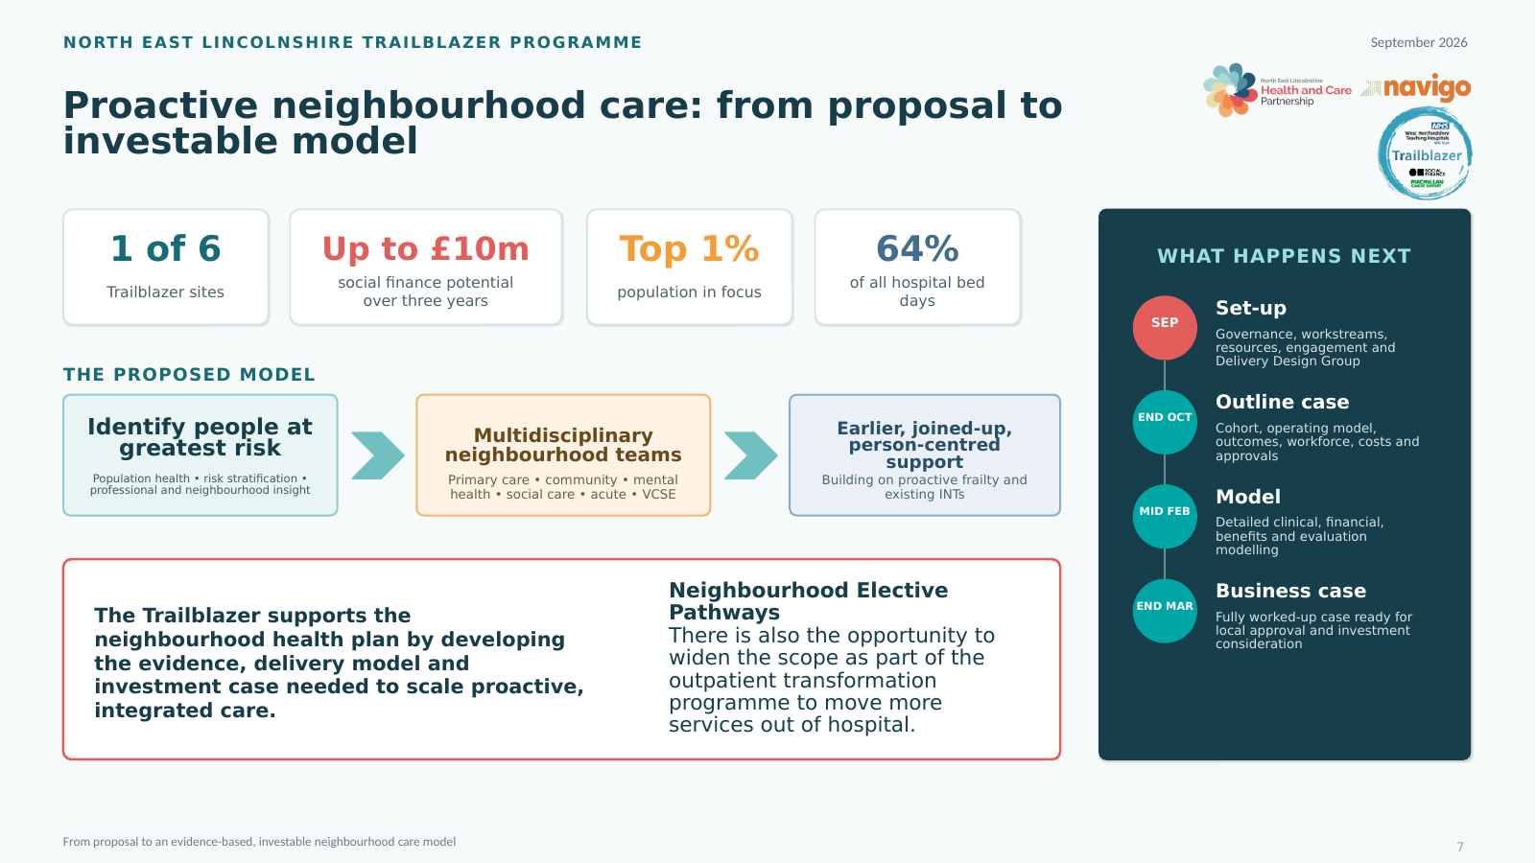
Potential social-finance investment, subject to business-case development, local governance and investment consideration.

Slide 45
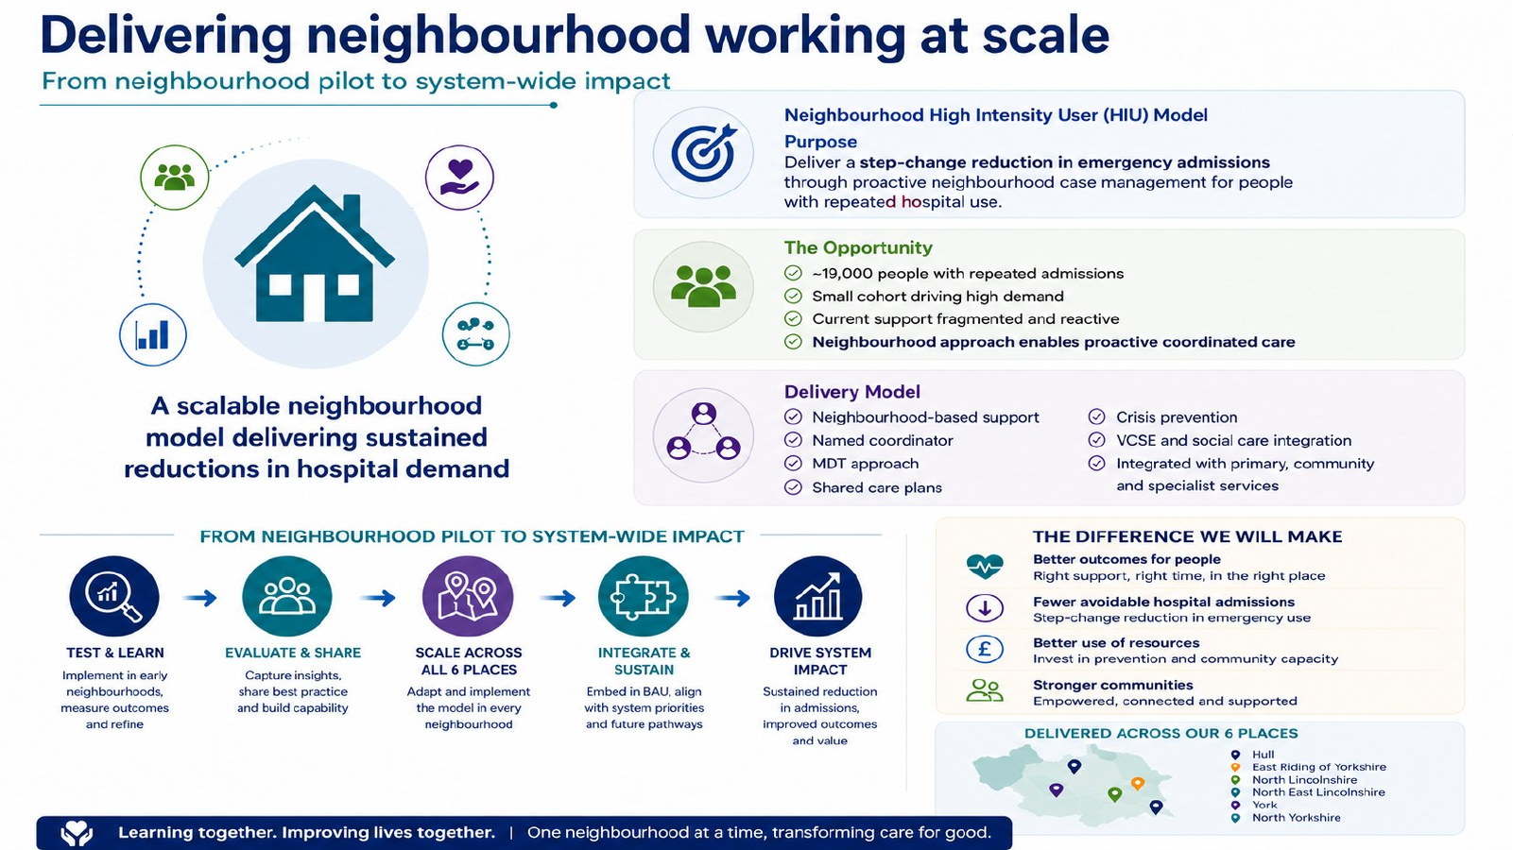
Notes:
[Sources]
- HNY Neighbourhood Health stocktake deck, slide 25
[/Sources]

Slide 46
NLaG’s contribution and next steps
Proposed contribution to the Trailblazer, for Governors and AGM discussion
Pathways
Cohorts
Model
Prioritise admission avoidance, discharge and care closer to home
Refine priority groups using service intelligence and clinical judgement
Co-design links between acute, community, primary care and wider partners
Benefits
Leadership
Test activity, quality, workforce and financial assumptions
Identify clinical and operational sponsors for the design workstreams

